Slide 1
Marriott & Data Axle MAU Foundation Work Session
March 7, 2023

Slide 2
Today, we will discuss…
Creative - MAU competitive examples and design and content inspiration
Strategy - Business objectives, program goals and test & learn agenda
Process – Initial process and workflow enhancement ideas
Next steps

Slide 3
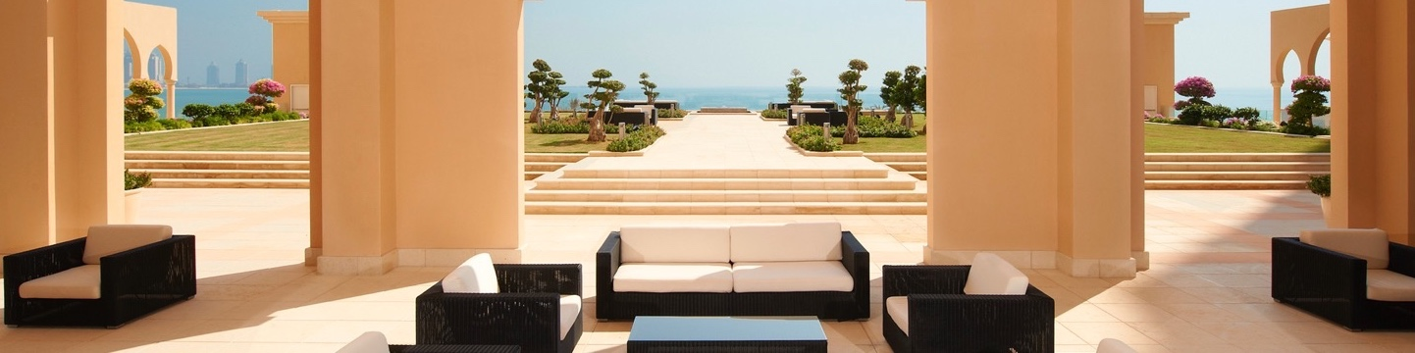
Let's review our direct & indirect competitors' monthly member communications
W DUBAI – THE PALM, UAE
We’ll discuss:
What we like, What we wish, & What we wonder

Slide 4
Direct Competitors

Slide 5
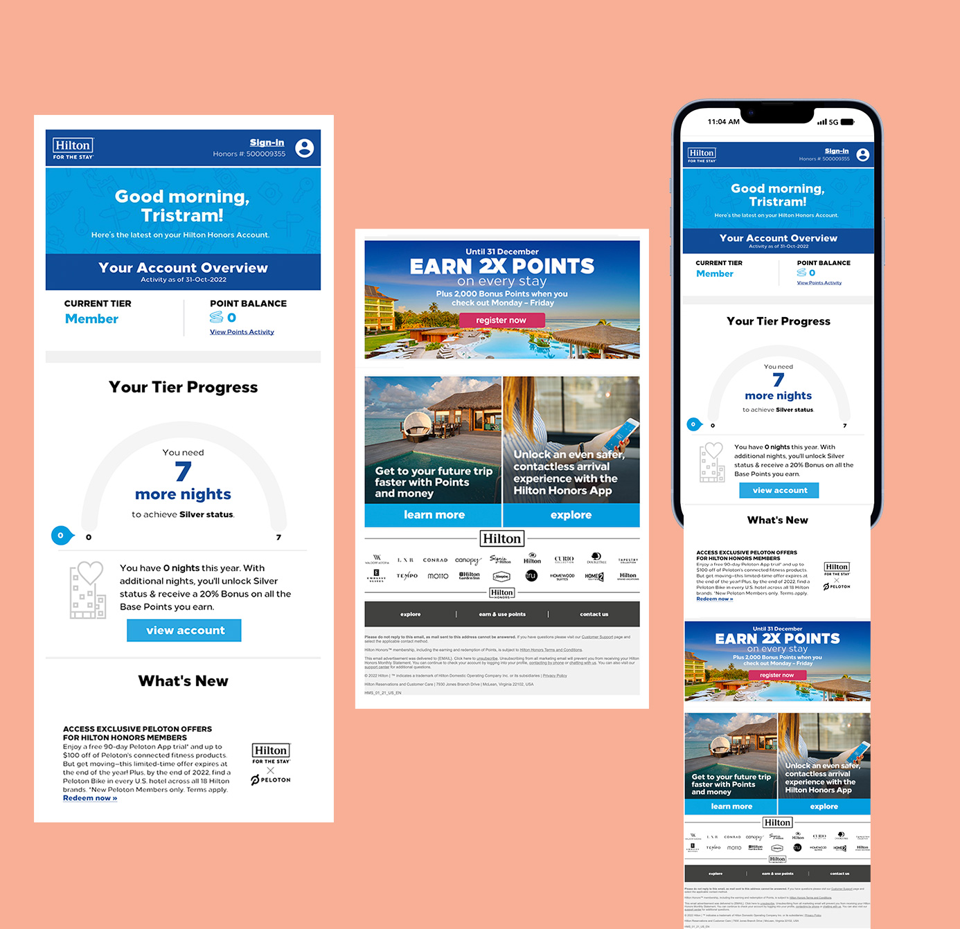

SL: Your Hilton Honors Monthly Statement
PH: Get the latest information about your membership here
What We Like
“Good morning, Tristram!” messaging
“What’s New” section header
What We Wish
Bring in intro messaging accurately
What We Wonder
Is there 3rd party tech that will allow us to
accurately message by time of open

Slide 6
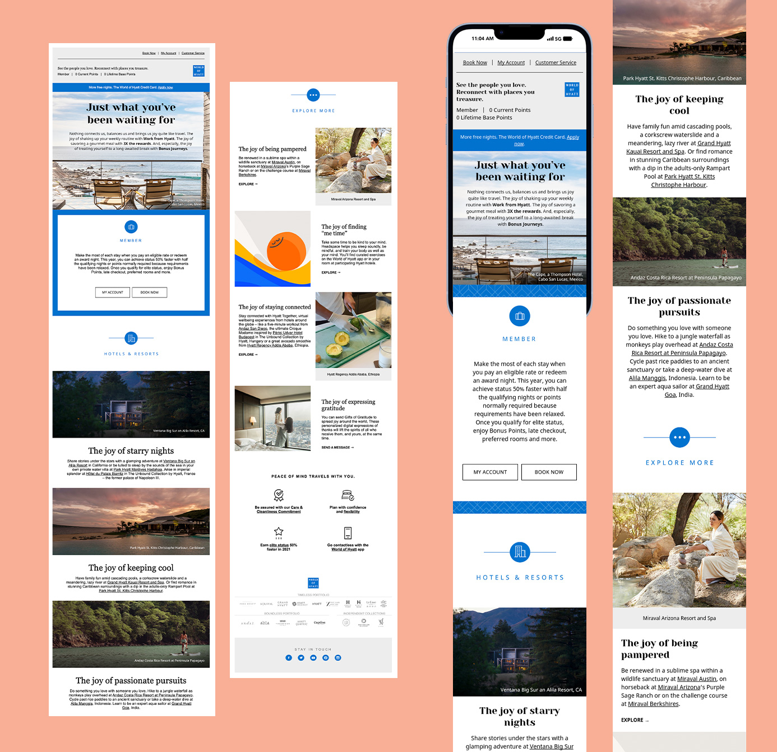

SL: Your Account Summary: Just What You’ve Been Waiting For
PH: See the people you love. Reconnect with places you treasure.
What We Like
“Just what you’ve been waiting for” tone of voice
Clear section dividers
Clean & organized layout
What We Wish
Make the MAU more enjoyable to read
Easily scannable with digestible & organized content
What We Wonder
Is there higher engagement when the members account information is divided around a visually engaging hero?

Slide 7
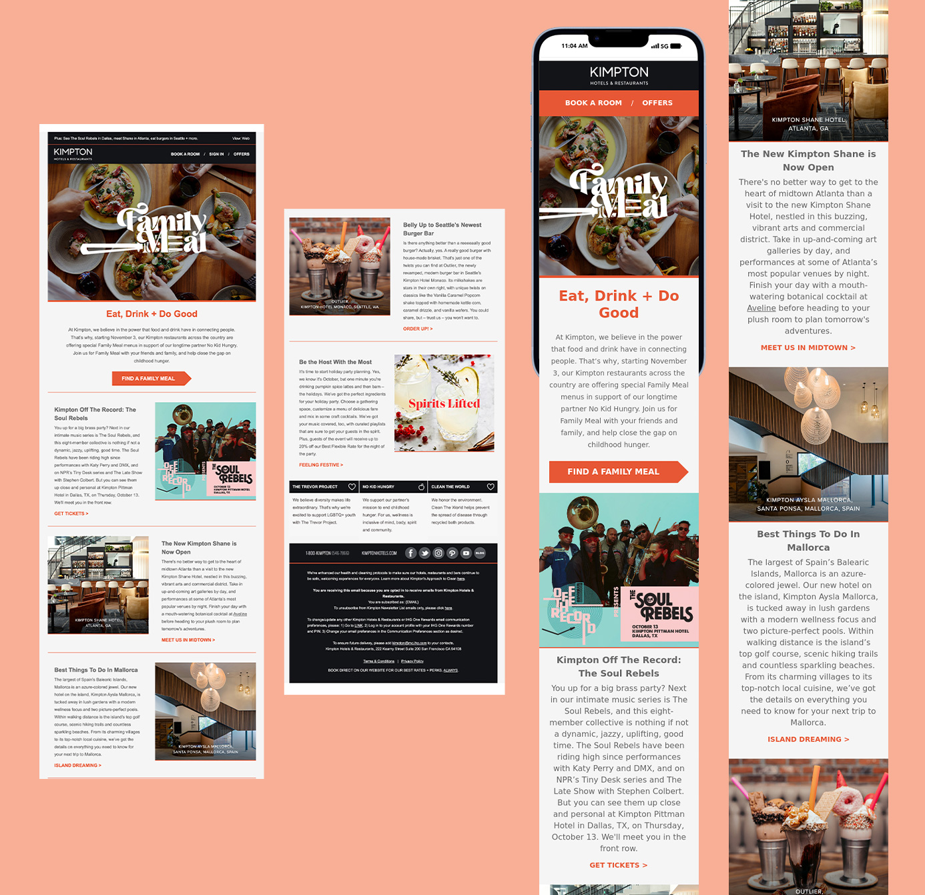

SL: {NAME}, your October Newsletter: Dine Out for Good at Family Meal
PH: Plus: See The Soul Rebels in Dallas, meet Shane in Atlanta, eat burgers in Seattle + more.
What We Like
Communicates brand initiatives
Clean & organized layout
What We Wish
Create opportunity to increase brand loyalty
through this communication
What We Wonder
Is there enough brand initiative content to message monthly? (ex. Current messaging to donate to relief efforts in Syria & Turkiye?)

Slide 8
Indirect Competitors

Slide 9
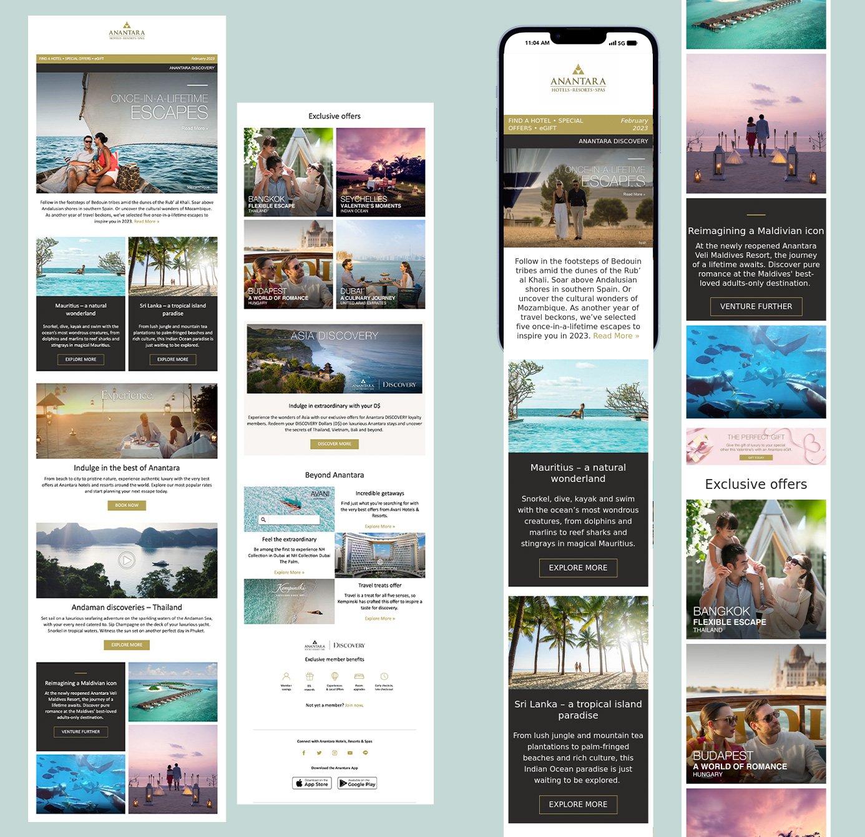

SL: February edition: Once-in-lifetime escapes, a Maldivian legend & Asia discovery
PH: Inspire your journey.
What We Like
Vibrant & engaging imagery
Mix of full-width & 2-column modules to vary the layout
Mobile app download in footer
What We Wish
Hotel feature module to spotlight new opening in a beautiful way to break up content
What We Wonder
Do members receive the benefits banner at the bottom? And if so, does it still get engagement?

Slide 10
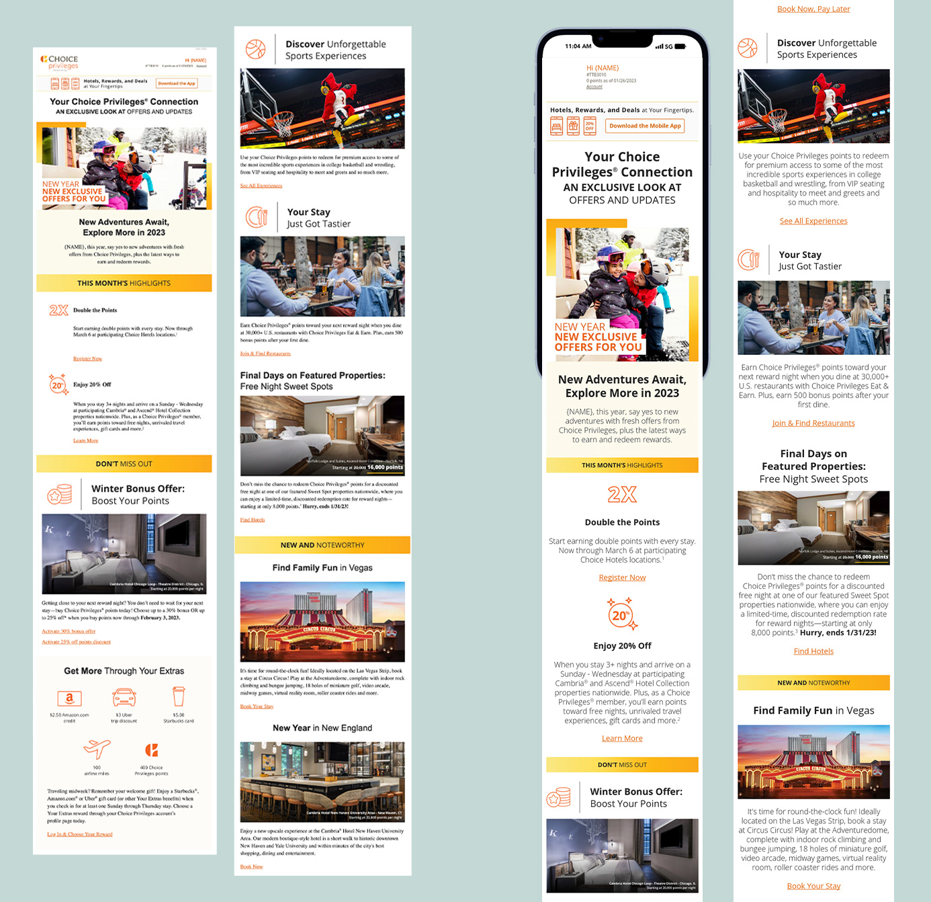

SL: It’s Here! Your January Update, Special Offers and More
PH: New Adventures Await
What We Like
Clear section dividers & use of iconography
Small mobile app banner
What We Wish
More scannable sections
What We Wonder
Is a small mobile app banner that’s always
on a good idea?

Slide 11
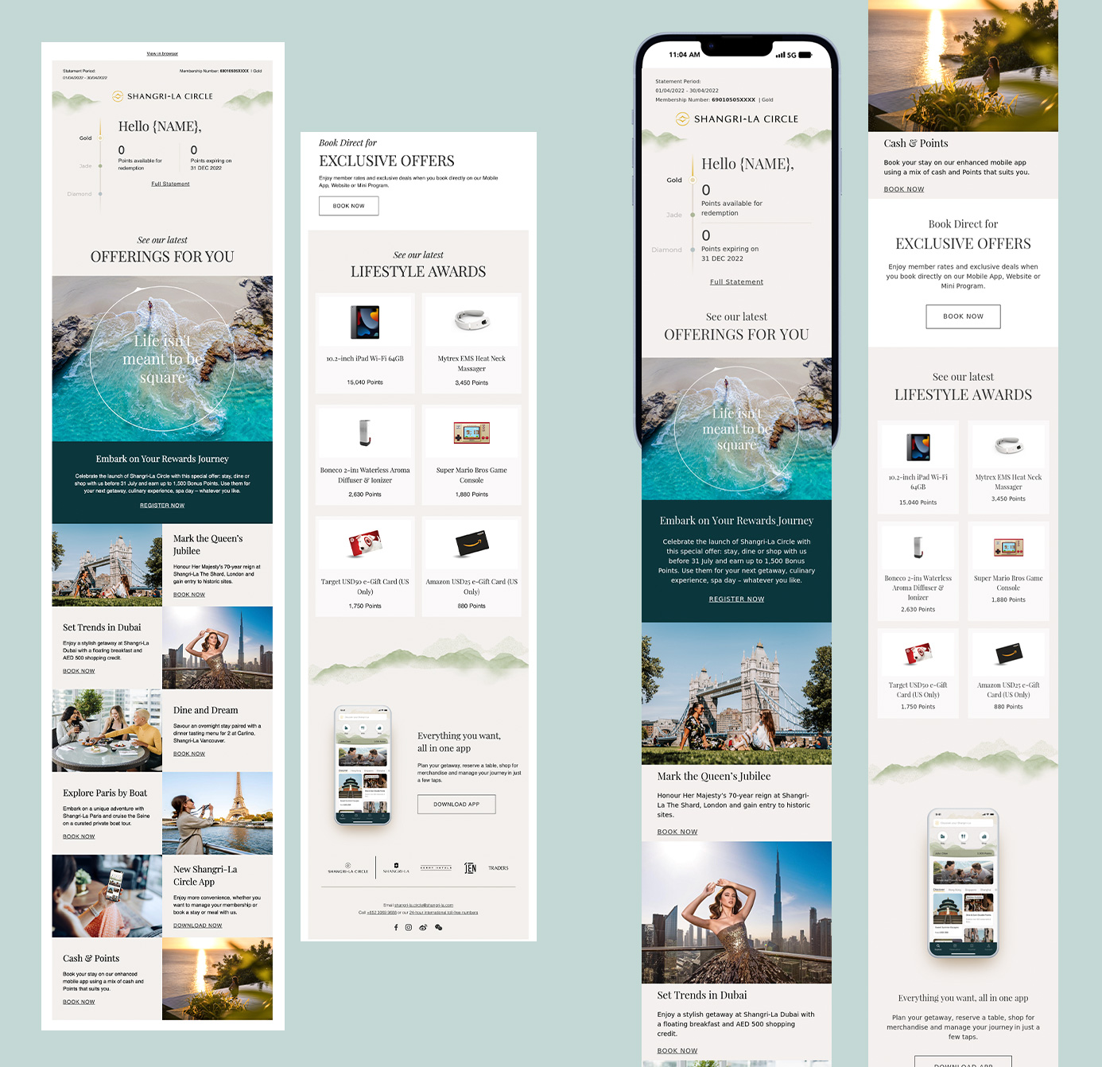

SL: Your Shangri-La Circle Account Summary
PH: Statement Period: 01/04/2022 - 30/04/2022 Membership Number: 69010505XXXX
What We Like
Beautifully designed layout
Clear, scannable sections
Mobile app module
What We Wish
To begin and book end the MAU with a nice treatment so it feels like one cohesive story
What We Wonder
Is there an opportunity for a “Book Direct” message to reinforce that members get the best rates?

Slide 12
Inspiration & Thought Starters

Slide 13

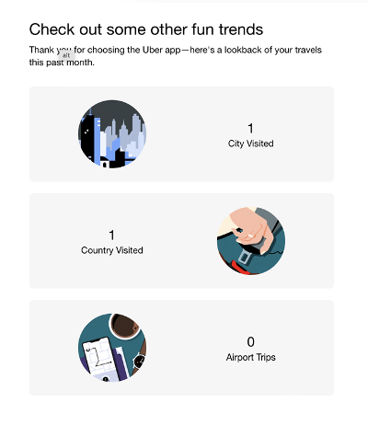

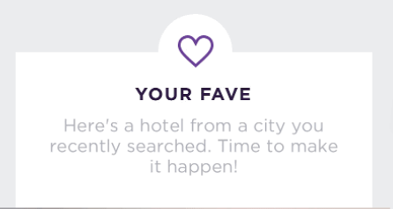

Enhanced Personalization
THE ST. REGIS MAURITIUS RESORT, LE MORNE, MAURITIUS
SHERATON ADDIS, A LUXURY COLLECTION HOTEL, ADDIS ABABA, ETHIOPIA
PALACIO DEL INKA, A LUXURY COLLECTION HOTEL, CUSCO, PERU
Timely messaging depending on time of open
Pull in of most recent hotel search, or a “favorite” data point (most frequented brand, destination, etc.)
Extra data point personalization

Slide 14

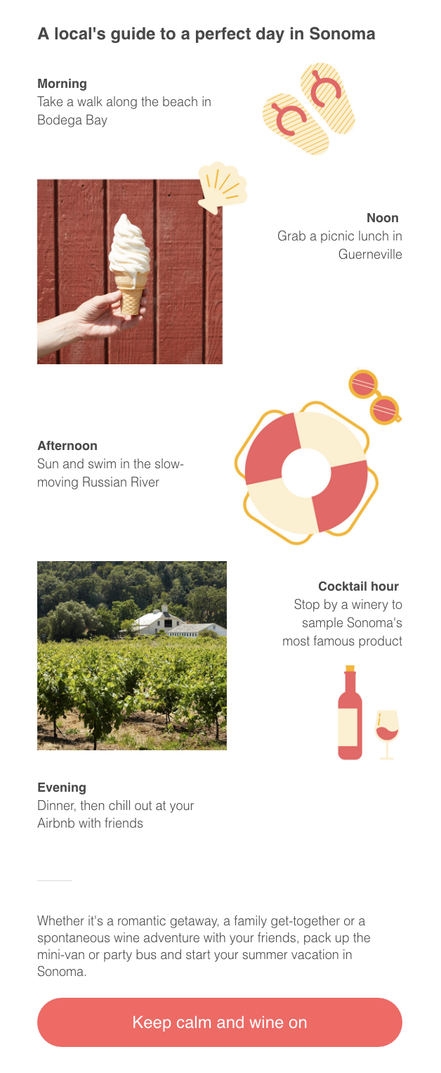

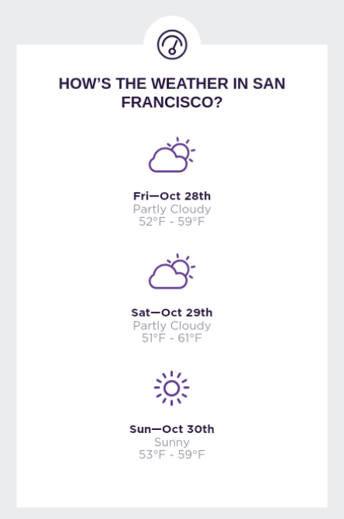

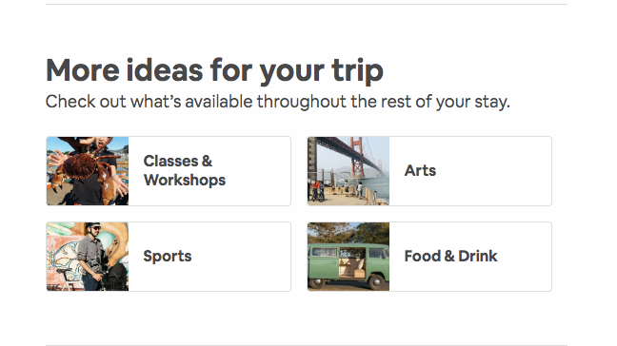
Enhanced Personalization
Upcoming Trip module with additional targeted content & widget ideas
THE ST. REGIS MAURITIUS RESORT, LE MORNE, MURITIUS
SHERATON ADDIS, A LUXURY COLLECTION HOTEL, ADDIS ABABA, ETHIOPI
PALACIO DEL INKA, A LUXURY COLLECTION HOTEL, CUSCO, PERU

Slide 15

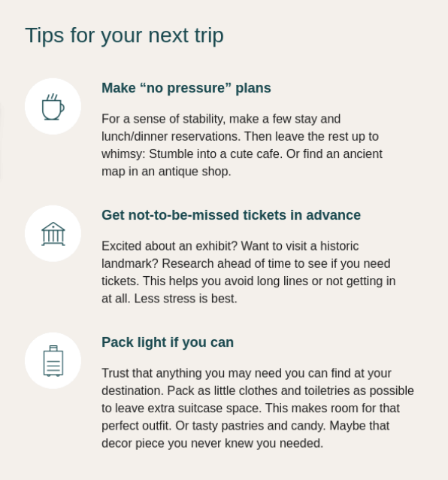

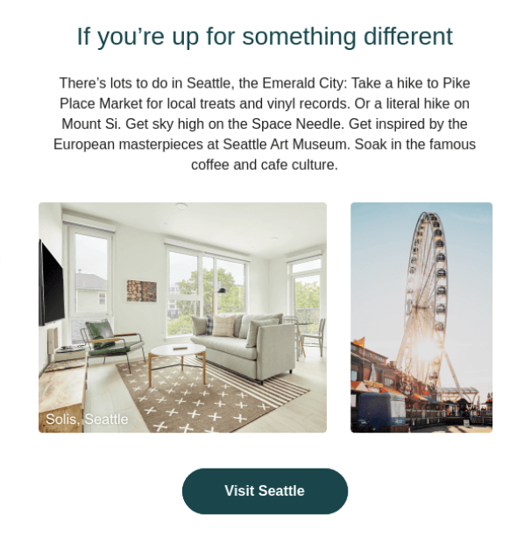
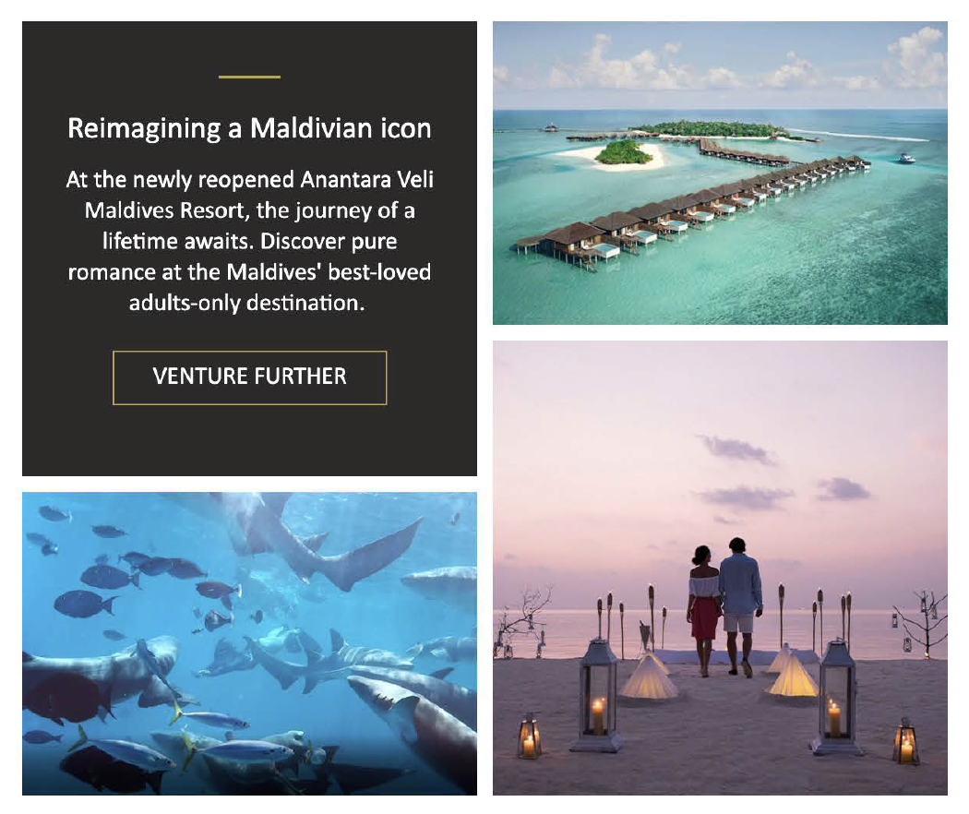

Enjoyable, Scroll-worthy Content
PALACIO DEL INKA, A LUXURY COLLECTION HOTEL, CUSCO, PERU
Travel guide
Hotel feature
Tips
Fun fact

Slide 16

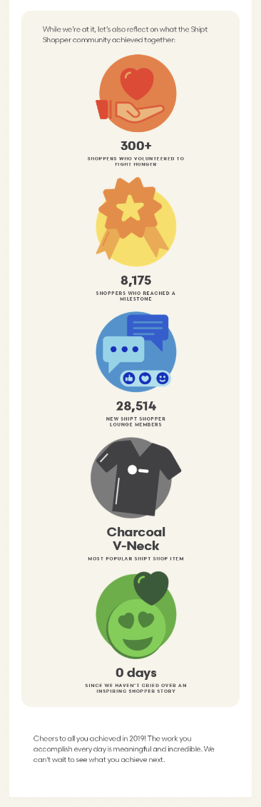
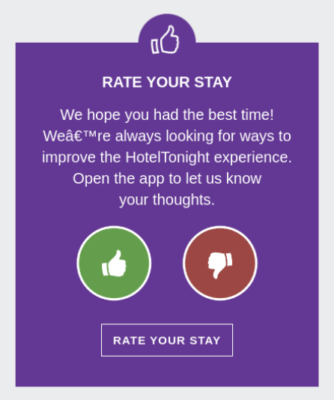
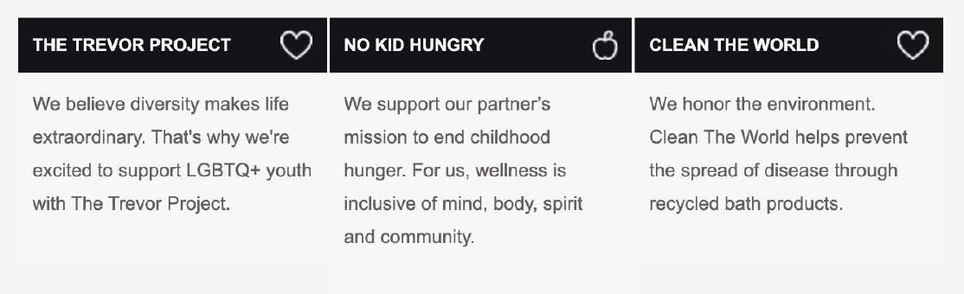
Brand Loyalty
THE ST. REGIS MAURITIUS RESORT, LE MORNE, MAURITIUS
SHERATON ADDIS, A LUXURY COLLECTION HOTEL, ADDIS ABABA, ETHIOPIA
PALACIO DEL INKA, A LUXURY COLLECTION HOTEL, CUSCO, PERU
Increase brand loyalty by showing which initiatives Marriott supports
Show members we care about their feedback
Show how the greater community is interacting with Marriott to reinforce loyalty

Slide 17
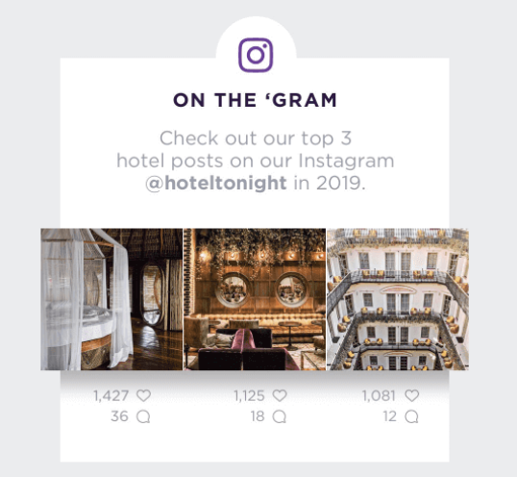
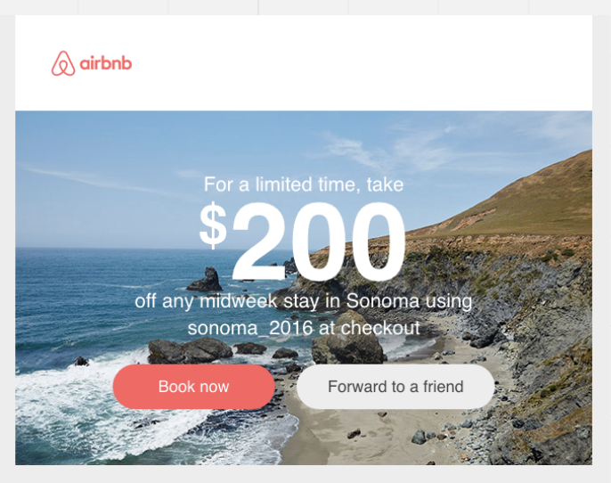

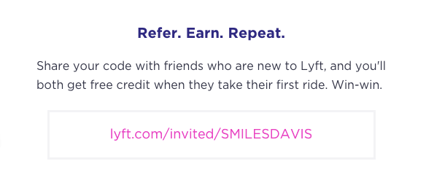
Brand Loyalty
THE ST. REGIS MAURITIUS RESORT, LE MORNE, MAURITIUS
Sharing among friends
Sharing among friends to increase loyalty
Inviting to follow along on social

Slide 18

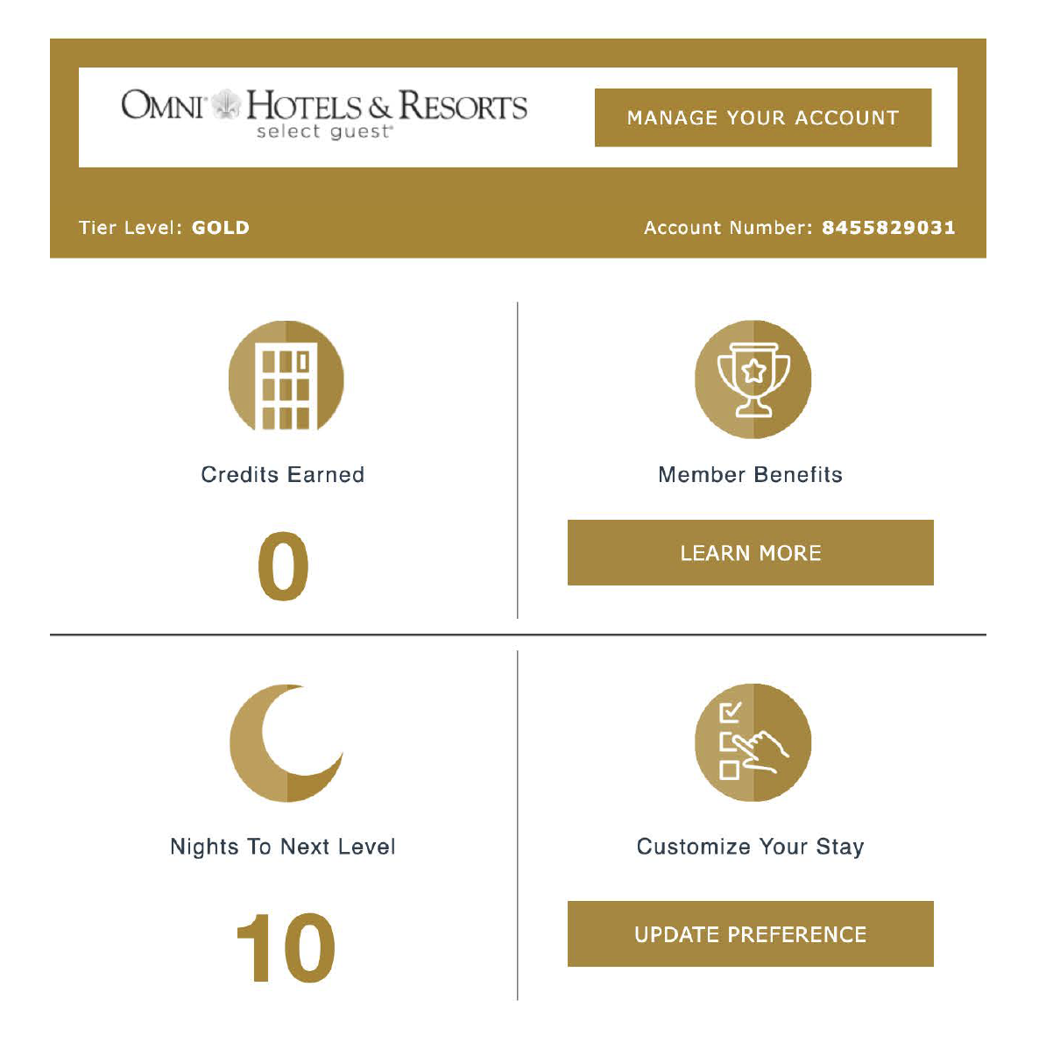
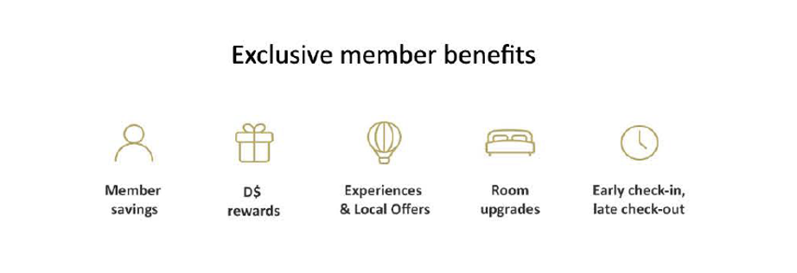
Brand Education
THE ST. REGIS MAURITIUS RESORT, LE MORNE, MAURITIUS
SHERATON ADDIS, A LUXURY COLLECTION HOTEL, ADDIS ABABA, ETHIOPIA
PALACIO DEL INKA, A LUXURY COLLECTION HOTEL, CUSCO, PERU
Remind readers of all their benefits as a member
Preference center quick link in account box to personalize their preferences

Slide 19
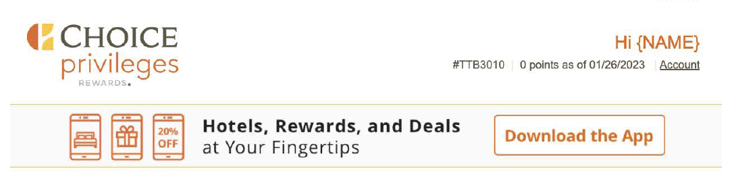
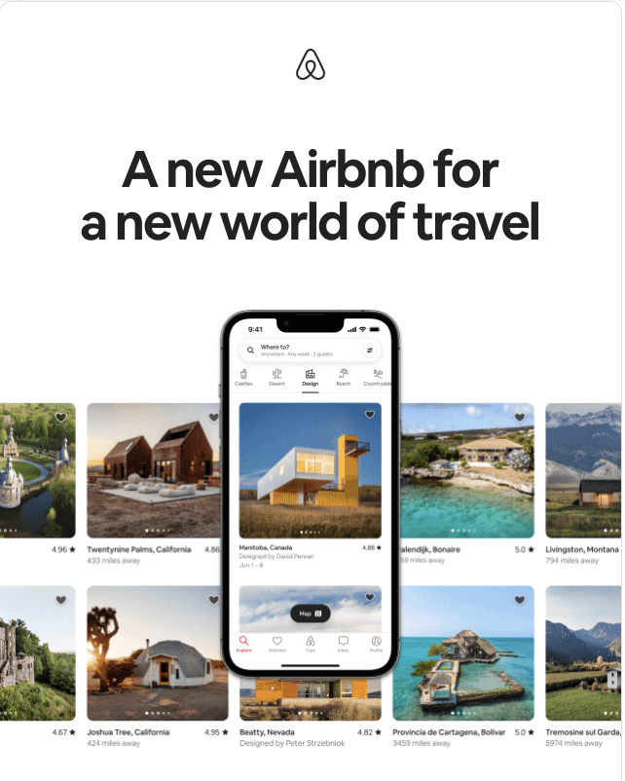
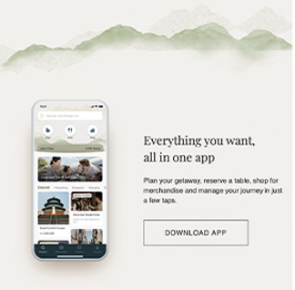
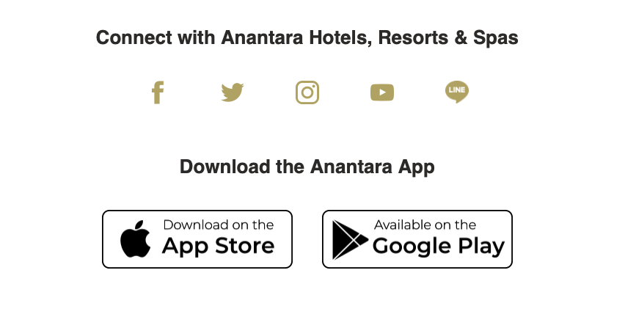


Brand Education
THE ST. REGIS MAURITIUS RESORT, LE MORNE, MAURITIUS
SHERATON ADDIS, A LUXURY COLLECTION HOTEL, ADDIS ABABA, ETHIOPIA
PALACIO DEL INKA, A LUXURY COLLECTION HOTEL, CUSCO, PERU
Create a neat interactive animation in a secondary module
Static, but more prominent, placement
Small banner or download icons in the footer

Slide 20

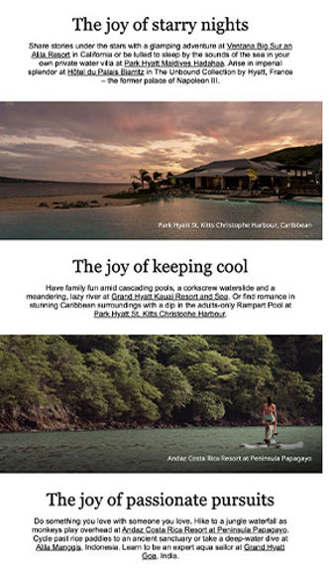





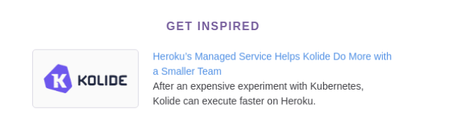

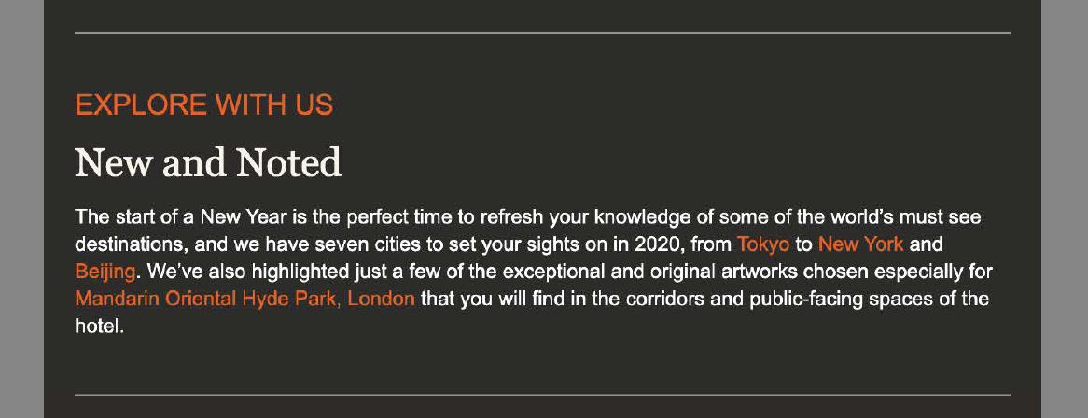

Hierarchy & Tone
THE ST. REGIS MAURITIUS RESORT, LE MORNE, MAURITIUS
PALACIO DEL INKA, A LUXURY COLLECTION HOTEL, CUSCO, PERU
Clear section dividers
Inspiring & timely tone

Slide 21


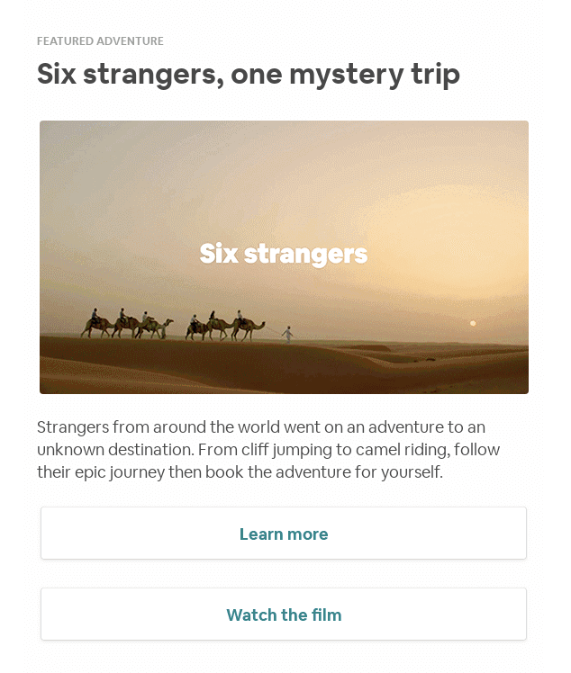



Interactivity
SHERATON ADDIS, A LUXURY COLLECTION HOTEL, ADDIS ABABA, ETHIOPIA
PALACIO DEL INKA, A LUXURY COLLECTION HOTEL, CUSCO, PERU
Engaging graphics
Opportunities to bring in video content

Slide 22



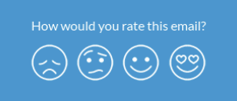

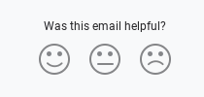
Ongoing Feedback
PALACIO DEL INKA, A LUXURY COLLECTION HOTEL, CUSCO, PERU
Ongoing feedback loop to gauge how well our readers are enjoying their MAU

Slide 23
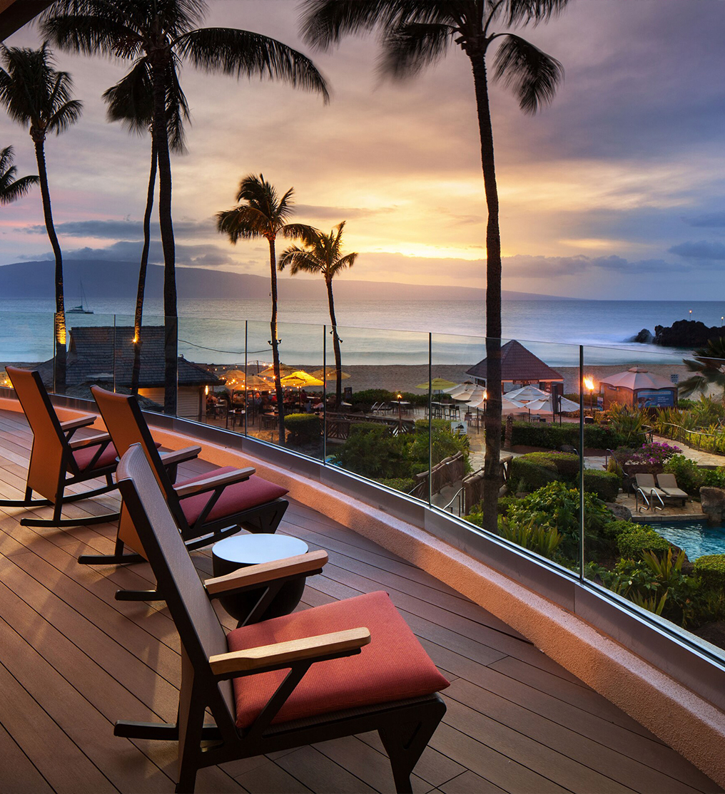

Strategy
Business objectives, program goals and test & learn agenda
SHERATON MAUI RESORT & SPA

Slide 24

Work Session Overview
Business Objectives
Program Goals
Campaign Strategy
New Key Segment Opportunities
Test & Learn Agenda
THE ST. REGIS MARDAVALL MALLORCA RESORT, PALMA DE MALLORCA, SPAIN

Slide 25


Core MAU Business Objectives
Building pride and growing engagement by utilizing personalization and dynamic content via a test and learn approach in order to deepen loyalty and drive revenue.
THE ST. REGIS MARDAVALL MALLORCA RESORT, PALMA DE MALLORCA, SPAIN

Slide 26
Core MAU Program Goals
Discuss / Determine KPI Goals
CTR
2019: 2.07% | Last 6 Months: 1.06%
Unsub Rate 2019: 0.21% | Last 6 Months: 0.13%
Revenue
2019: $10.7 M | Last 6 Months: $4.5 M
Room Nights
2019: 52.1 K | Last 6 Months: 45.8 K
Additional KPI Goals For Consideration:
Sub-Segments: Member Level, Tenure, Opportunity Segments
Lifecyle Stages
Content: Cobrand, Global Promo, etc.

Slide 27
Core MAU Program Goals
Discuss / Determine Project Pillar Goals For Consideration
Develop Test & Learn Agenda To Propel / Inform Personalization & Dynamic Content
Introduce Tailored Content By Segment
Enhance Brand Education: Utilizing Propensity Models; Brand Portfolio Pull Throughs
Implement Surveys / Polls To Garner Content Interests
Kickoff 2024 Planning Efforts

Slide 28
Core MAU Campaign Strategy
Key Campaign Strategy Pillars For 2023
Determine Focus Areas For Improvement & Optimization Tied To A Test & Learn Agenda
Capture Primary & Secondary Baseline KPIs (Revenue, CTR, Unsub Rate, Program Engagement)
Identify New Key Segments For Content Versioning, Personalization & Reporting Only
Look For Connections With Luxury MAU: Program Messages, Offers & Testing Opportunities
Expand Regional / Localization Content Efforts
Feedback Loop To Stakeholders

Slide 29
New Key Segment Opportunities
Potential New Segment Opportunities For Consideration
1
2
3
4
New Members: Joined The Program 0-100 | 101+ Days Ago
Inactive Members:
Has Not Earned Points Or Redeemed In The Last 3, 6, 9, Months
High Average Daily Rate (ADR) Audience
Cobrand Cardholder vs. Non-Cardholder

Slide 30
Test & Learn Agenda | Approach
Explore: Identify what we want to know and learn
What information is currently missing?
What have we wondered about?
What assumptions would we like to confirm?
Vet: Make sure we are seeking the right knowledge, in the right order
Will the acquired knowledge be useful in developing future strategy?
Is the acquired data or learning map to business objectives and goals?
What’s first? De-prioritize the ideas that do not meet above criteria
Construct: Develop iterative test plan focused on key test areas
Identify the appropriate learning approach
Prioritize tests based on whether it is impactful, executable, and measurable
Document: Document learnings and recent recommendations
Refer to past learnings to develop strategies as well as inform future learning initiatives
Update test section on campaign roadmap quarterly

Slide 31
Test & Learn Whiteboard | Building Pride & Growing Engagement
IQ & Segmentation
Leisure Modules
Moments
Brand Propensity
Lifestyle Data / Personas
Condensed Version For New Members
Tailored Content By Segment
Inactive Members
Ambassadors
Incrementality
Active Member - Propel To New Product / Brand
New Key Segment Opportunities
Content & Layout
Inclusion Of Videos
Module Hierarchy
Countdown Timer
Polling
Milestone Messaging
Themed Editions
Seasonal Drivers
Brand Activations
‘Did You Know’ Content
Brand Education & Content
Offers & Localization
Gated Offers
Region Specific Modules

Slide 32
Process
Initial process and workflow enhancement review
SHERATON MAUI RESORT & SPA

Slide 33

Submissions
Submission Form Updates
Submission Review
Shift to 2 days after the solicitation is closed.
Future changes:
Workfront Submissions
Cobrand Submissions through Workfront

Slide 34
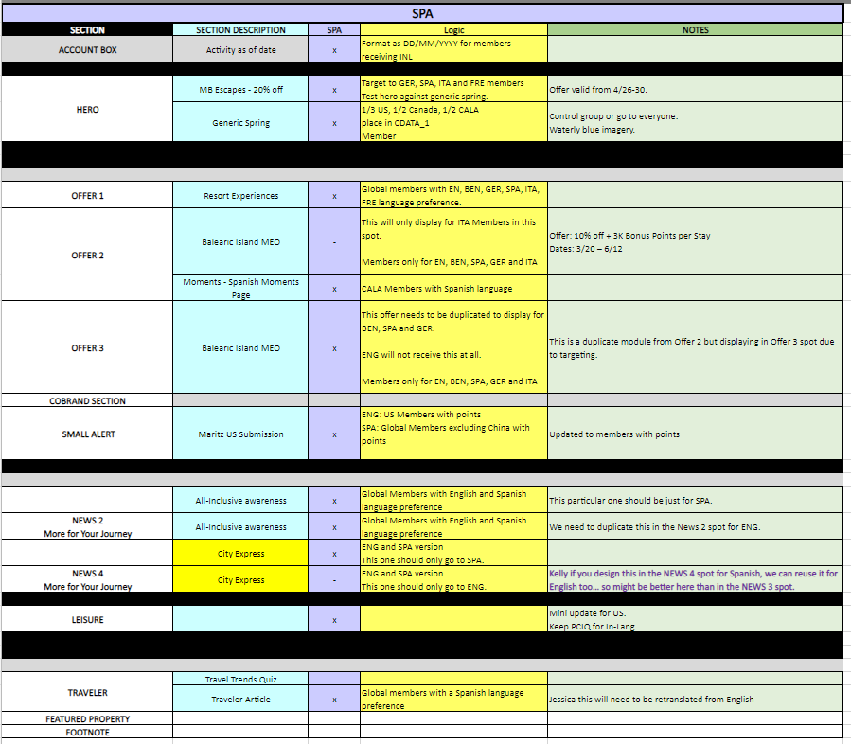
Grid
Regional Review
Provide Grid by language for regional review to EMEA and Americas regions before design starts.
This will hopefully aid in adding more content for the regions in the future.
Grid Layout Refresh
Evergreen Content

Slide 35
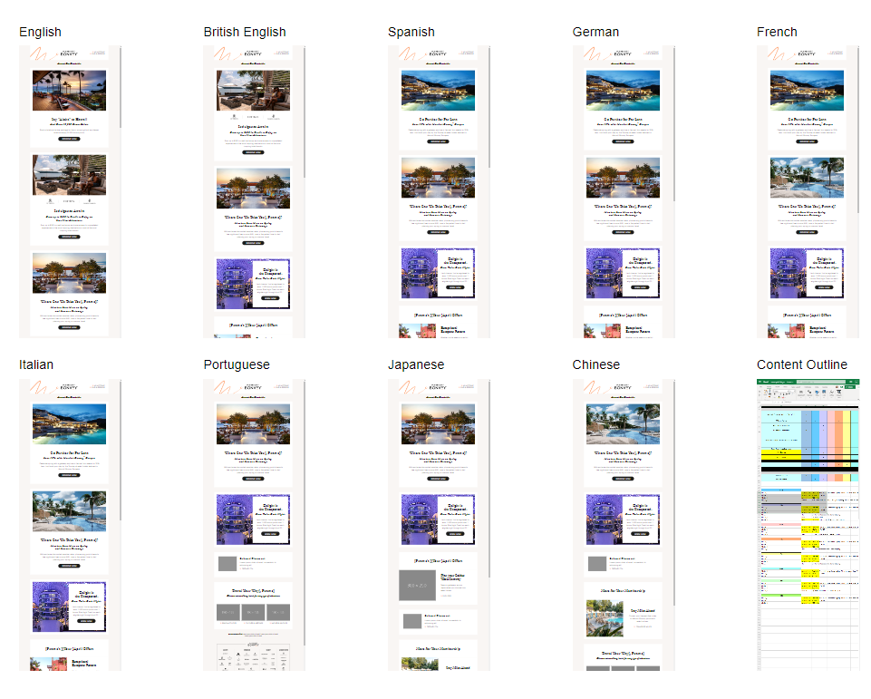
Design
Designing by region with April
This will hopefully help regions get a sample of what to expect earlier on and make content easier to digest.
The grid will also be included to help on an offer/content level.

Slide 36
Data
Data into Adobe
Data Process
Targeting and testing
Deployment Delays
THE ST. REGIS MARDAVALL MALLORCA RESORT, PALMA DE MALLORCA, SPAIN

Slide 37
Next Steps
Timing | Notes | Milestone | Description
Thursday, March 23rd | Available 60-minute timeslots | Initial Presentation Strategy | Share analysis, benchmarks, and plan roadmap items
Thursday, March 30th | Onsite Marriott HQ Would 12-2PM work (including lunch)? Anyone additional you want us to extend the invite to? Interest and availability in dinner on Wednesday, March 29th? | Final Presentation | Present analysis, opportunities for expanding and optimizing the newsletter, and test & learn roadmap Present creative and content go-forward approach Present process and workflow enhancement go-forward approach

Slide 38
Thank You!

