Slide 1
Creative Ideas DESIGN • TECH • CONTENT
Yesmail Creative Team

Slide 2
Creative Ideas DESIGN

Slide 3


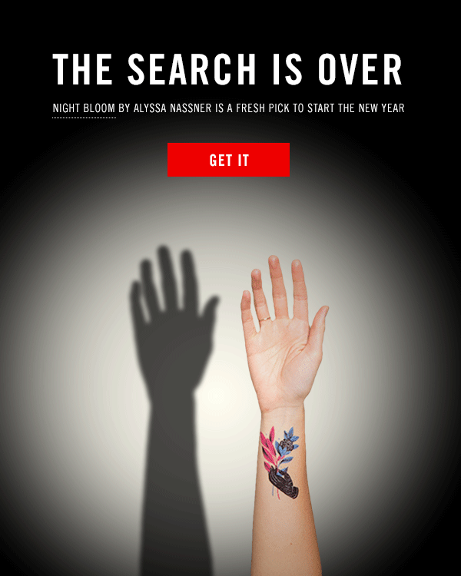
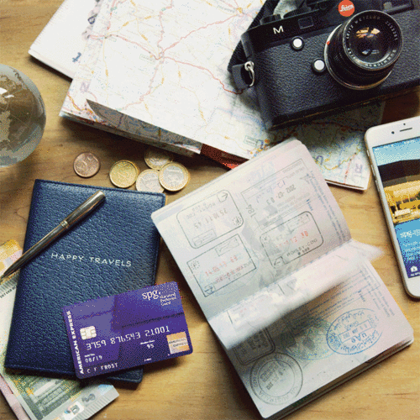
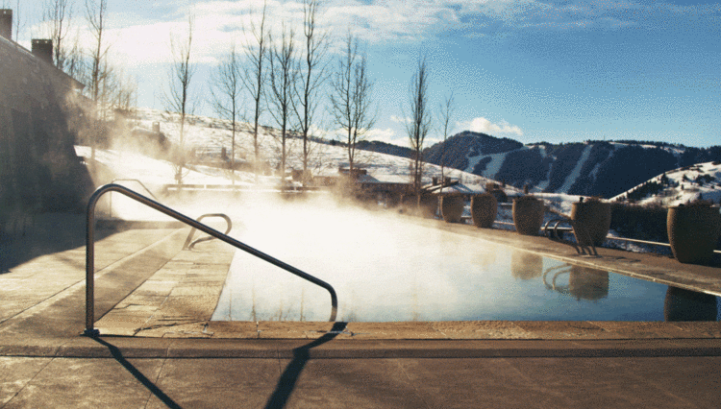
Cinemagraphs
“A living moment in an otherwise still photograph”
Brings an image to life in an elegant & unexpected way

Slide 4



Cinemagraphs

Slide 5
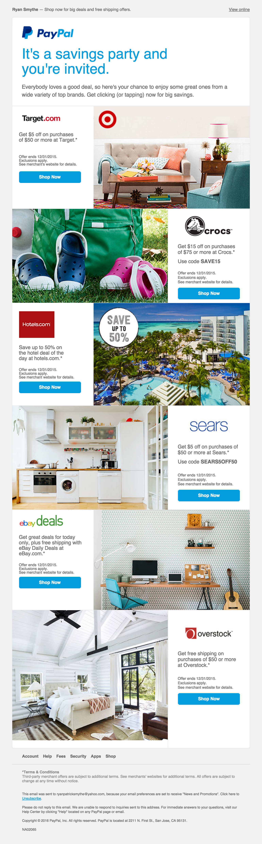
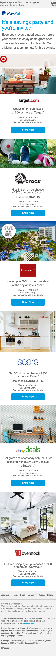
Masonry Style Layout
3 column grid
Desktop: alternating 2/3 image,1/3 copy
Mobile: stacking

Slide 6
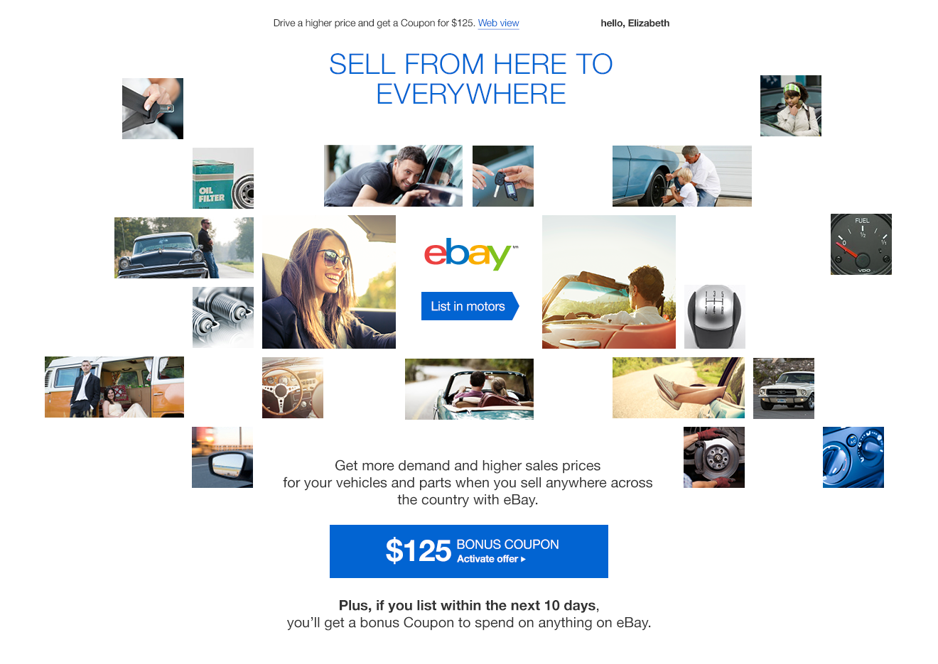
Masonry Style Layout

Slide 7
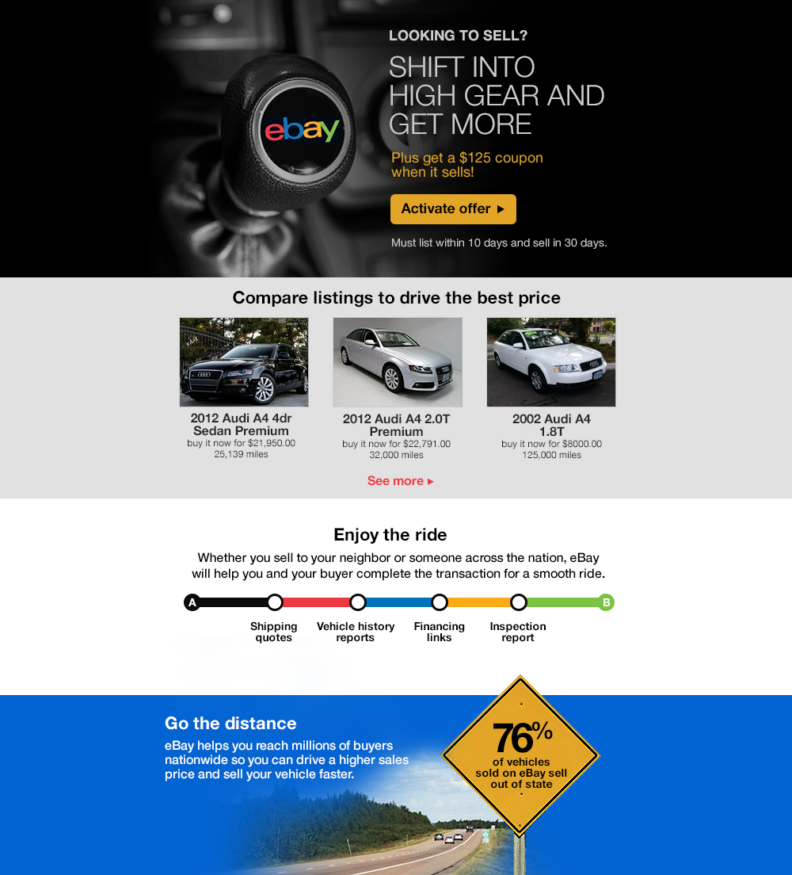
Full Width Layering

Slide 8
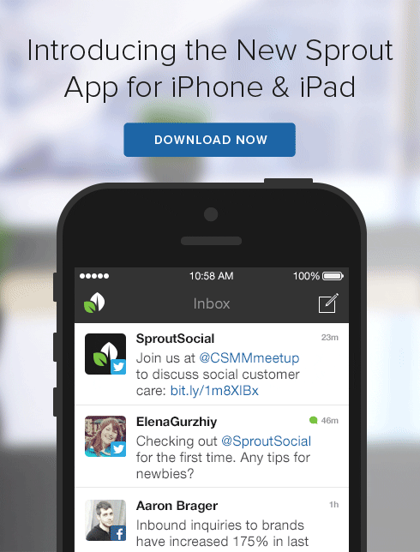
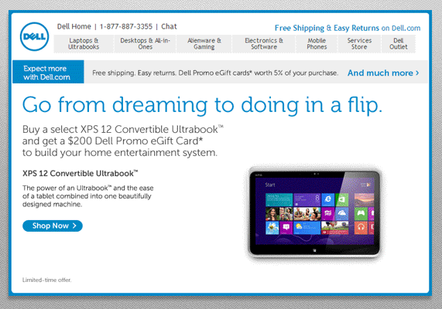
Animated GIFs
http://preview.4at5.net/email_domains/mar/9015/gifs.html
To showcase new products, interfaces, etc.

Slide 9
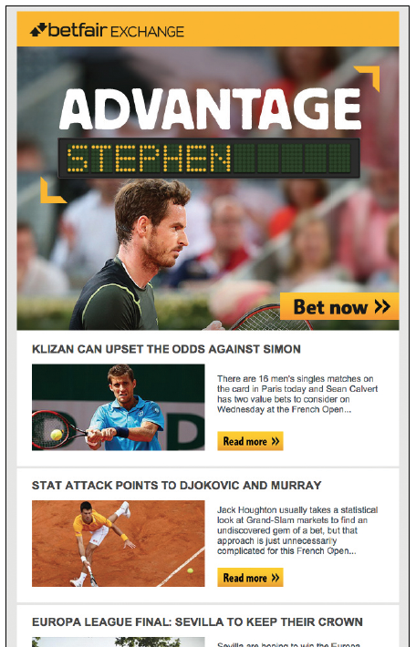
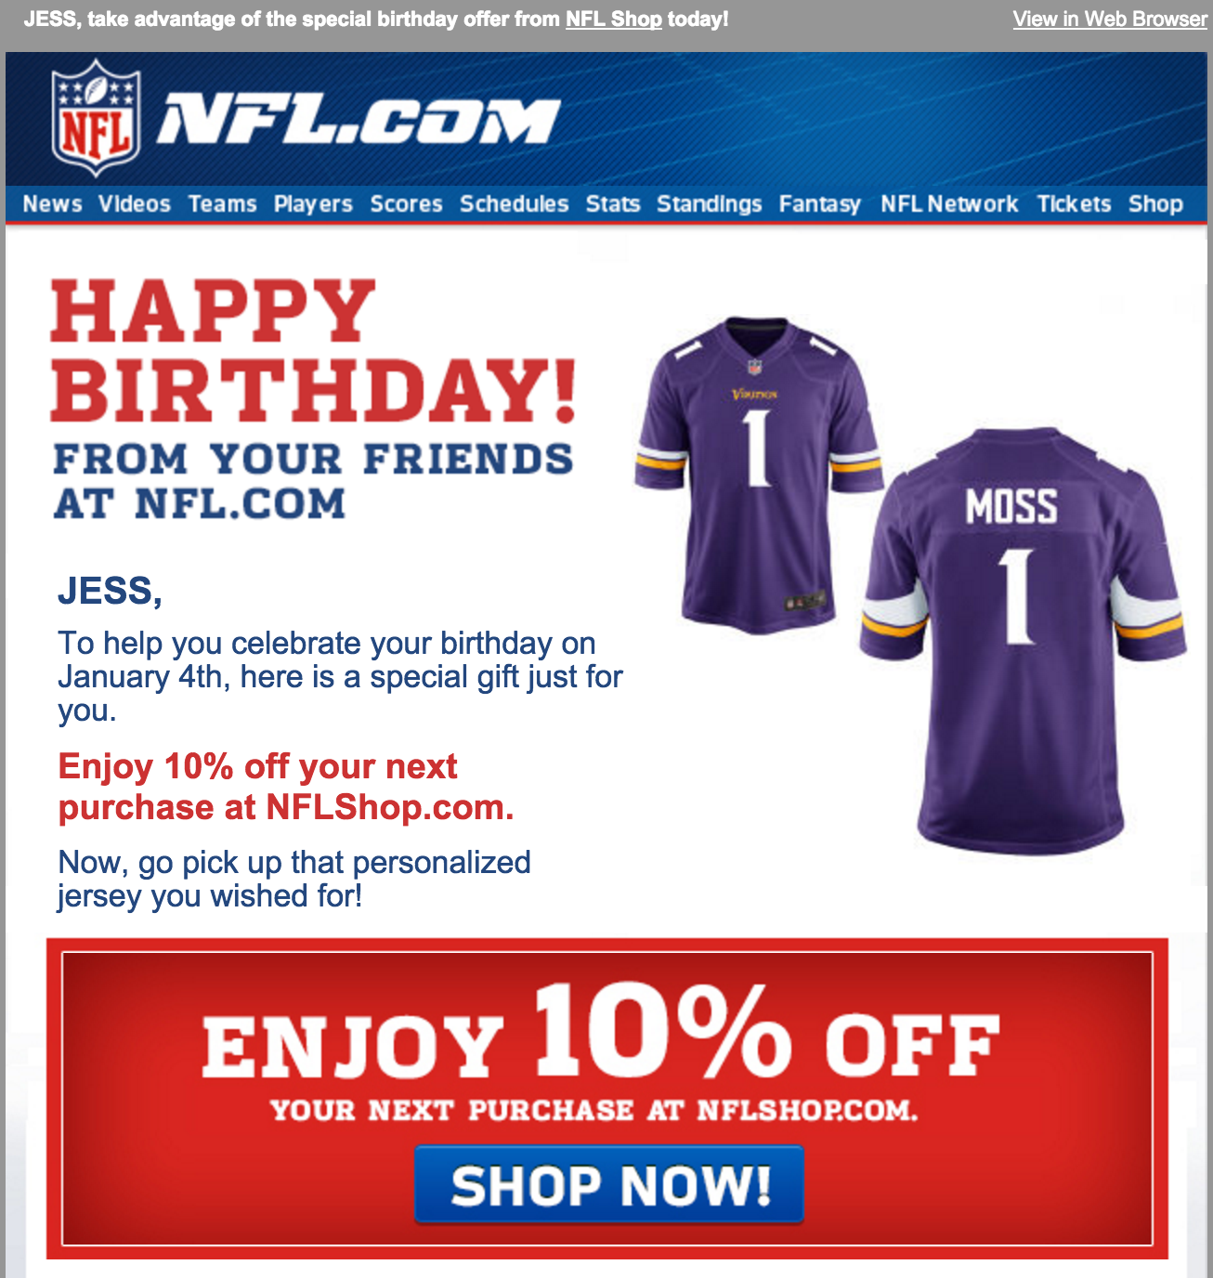

Creative Personalization

Slide 10
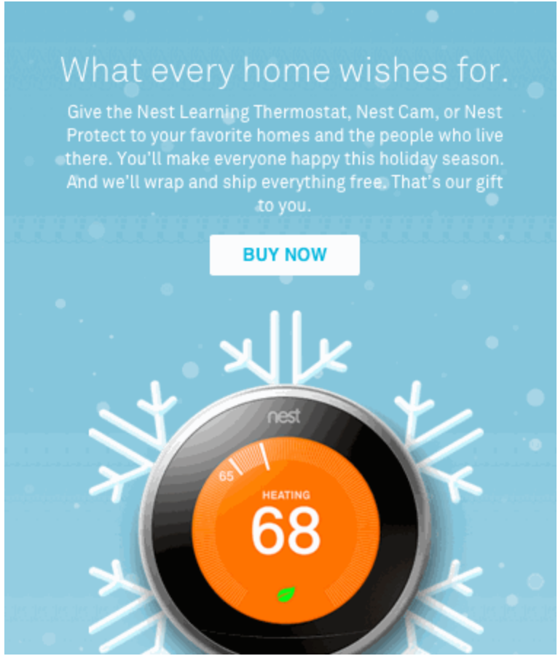
CSS Animations
Gimmicky, but eye-catching
See Live:
http://preview.4at5.net/email_domains/mar/9015/css_animation.html

Slide 11
Creative Ideas TECH

Slide 12
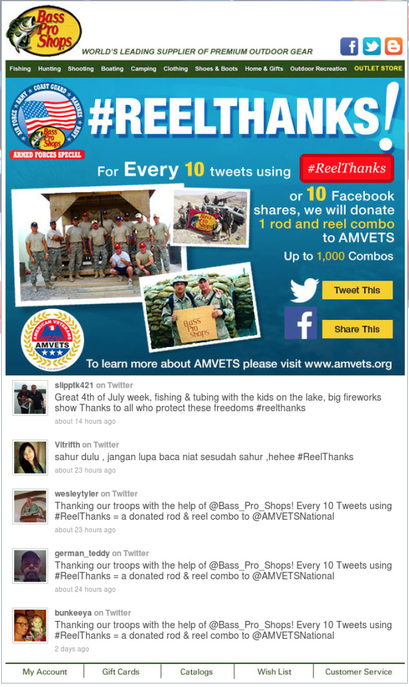
Social Feeds
Live Twitter feed
Donation to AMVETS

Slide 13
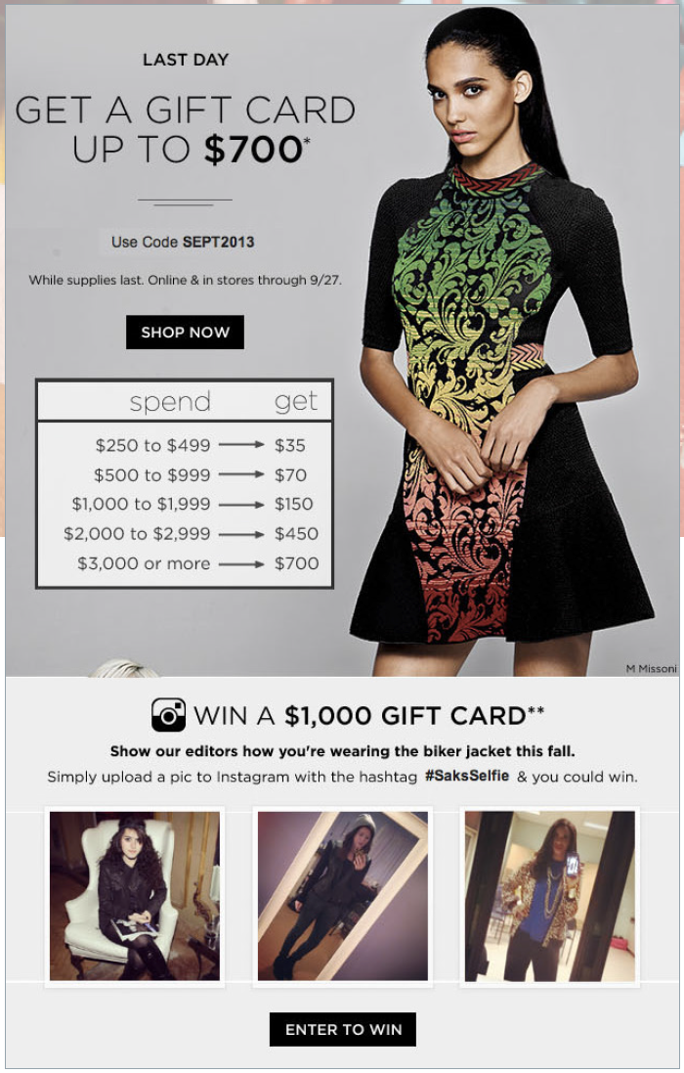
Social Feeds
Instagram sweepkstakes

Slide 14
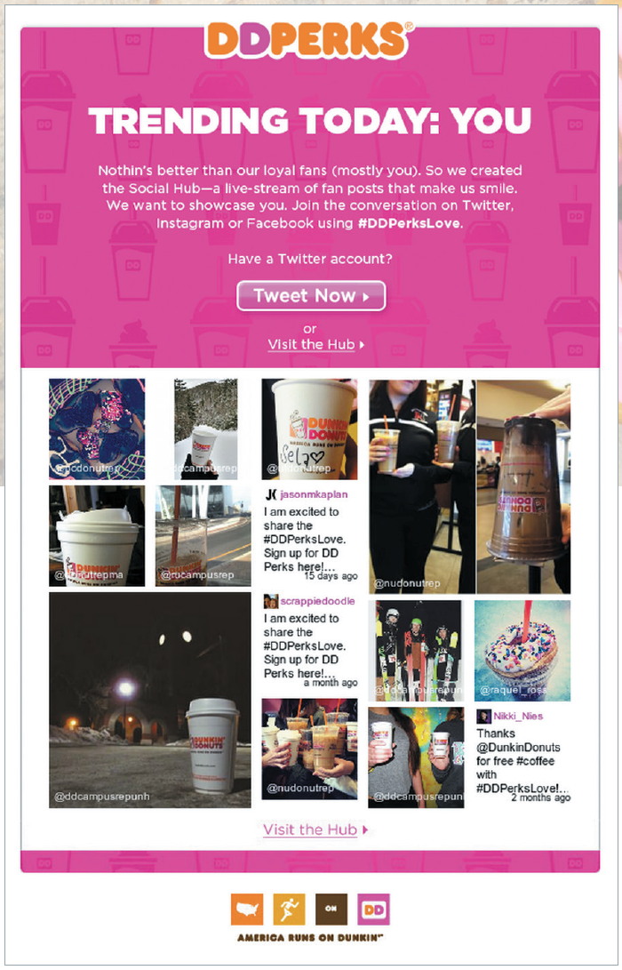
Social Feeds
User-generated content
Twitter and Instagram tagged #DDPerksLove

Slide 15
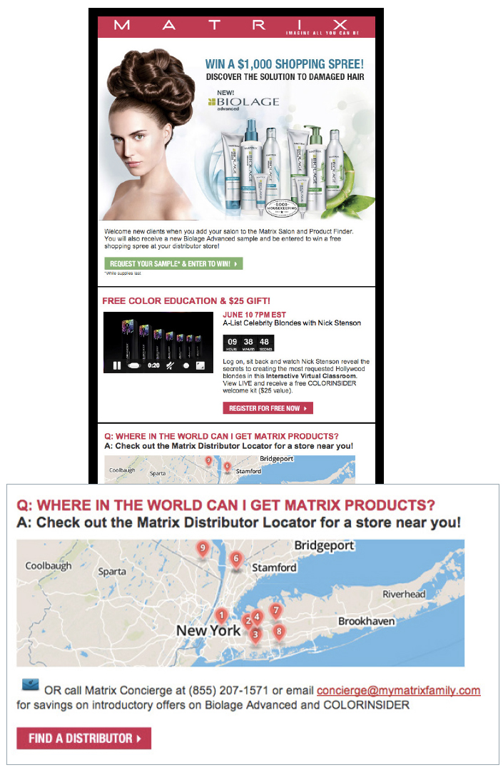
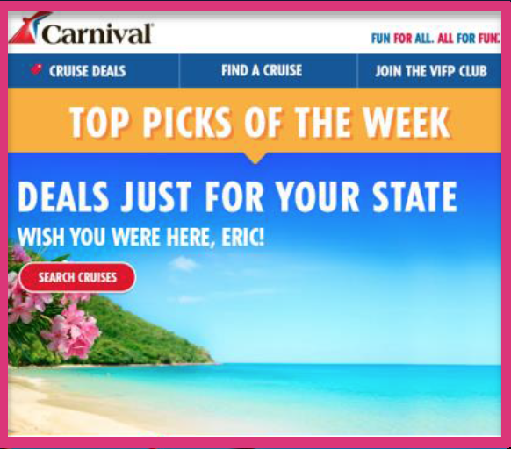
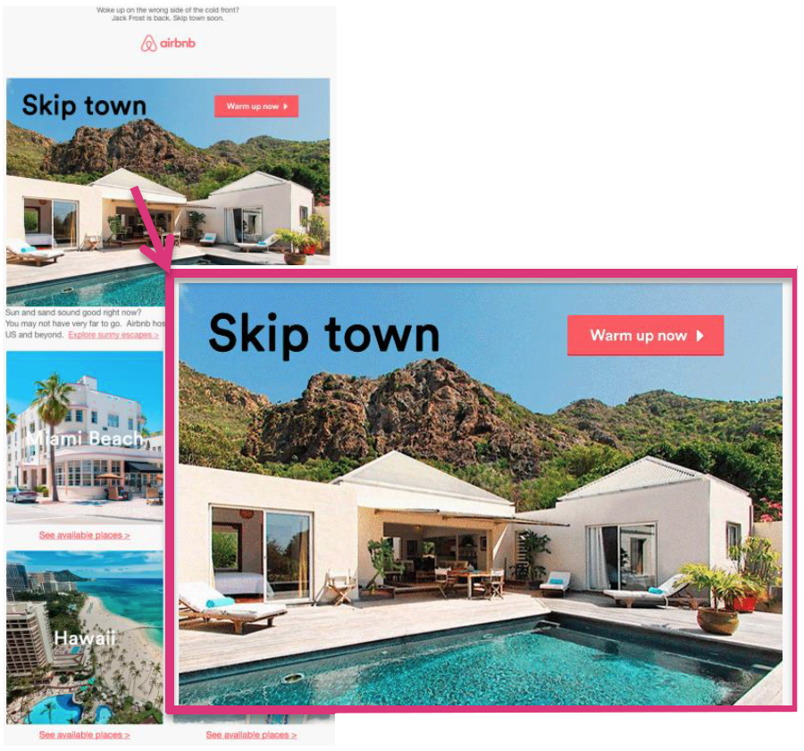
Geo-Targeting

Slide 16
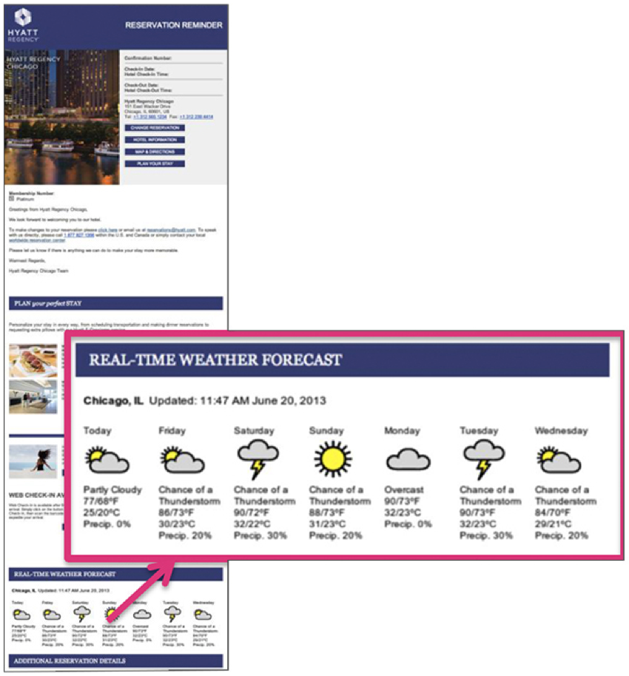
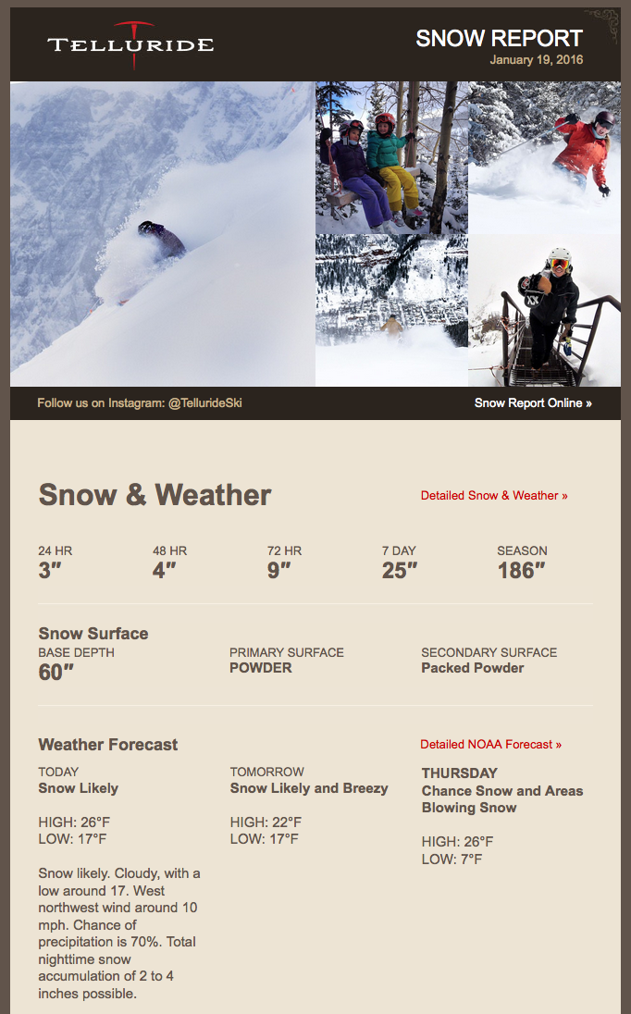
Real Time Weather
eNews Upcoming Reservations
City Scene Overlay

Slide 17

Weather Triggers
Targeting regions expecting snow
SL: Snow Coming! Get Your Pet’s Paws Prepared!!
PH: Is your pet snow-ready?

Slide 18
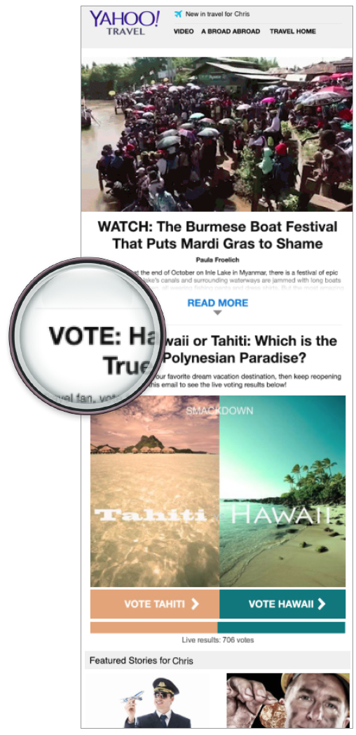
Polls/Surveys
Which location would you rather visit?

Slide 19
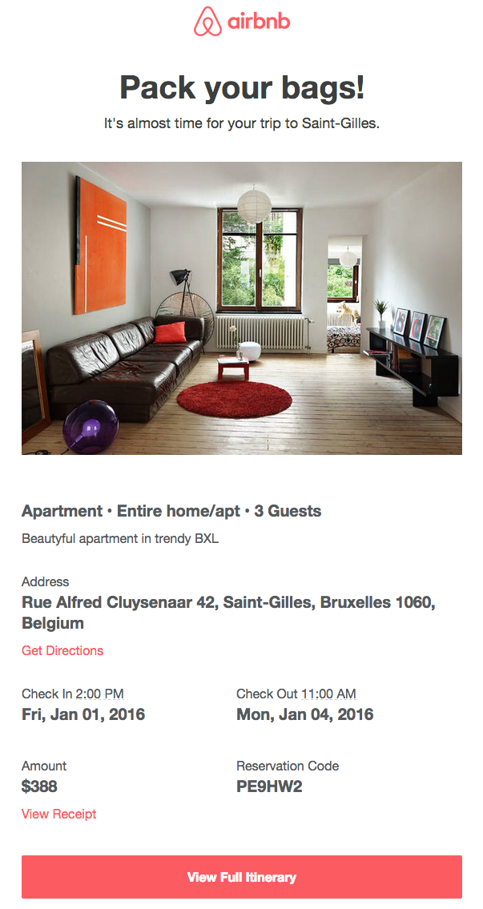
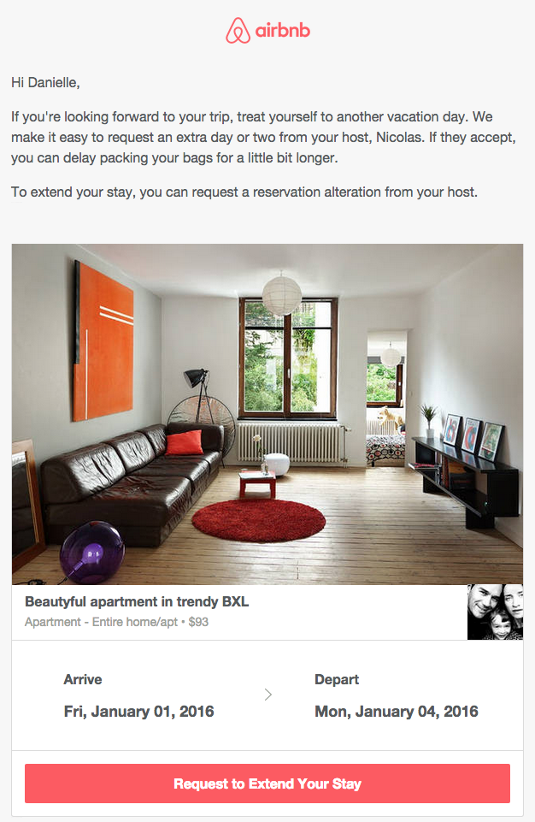
Calendar Reminders
Trigger sent days before trip asking if customer wants to extend the stay
Reminder sent both one week & one day prior to trip

Slide 20
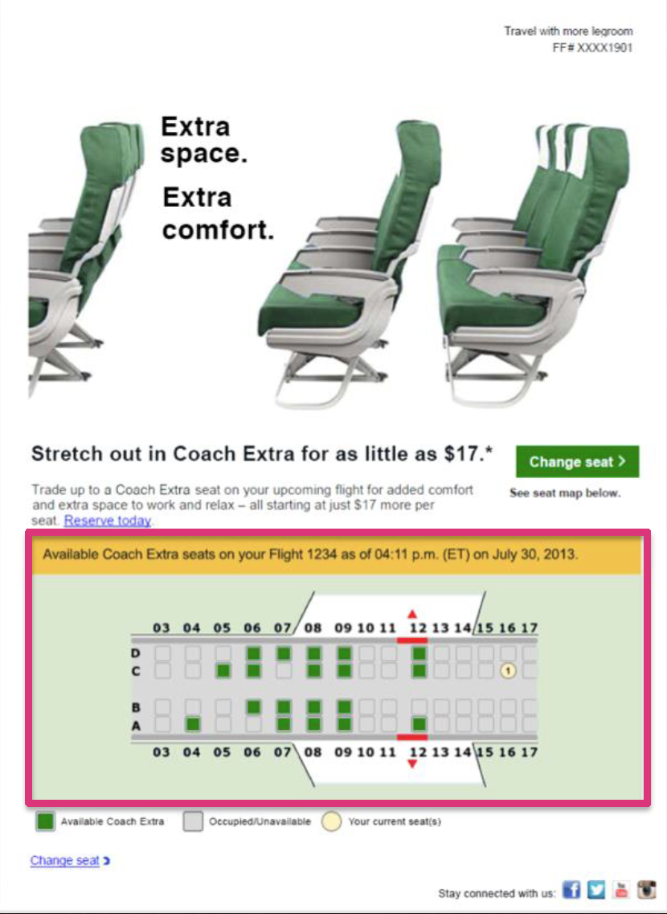
Web Scrape
Real-time inventory
Offers or dynamic content within email

Slide 21
Creative Ideas CONTENT

Slide 22
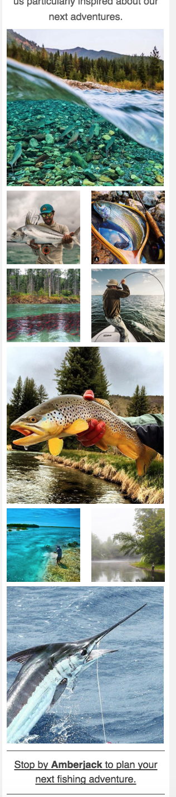
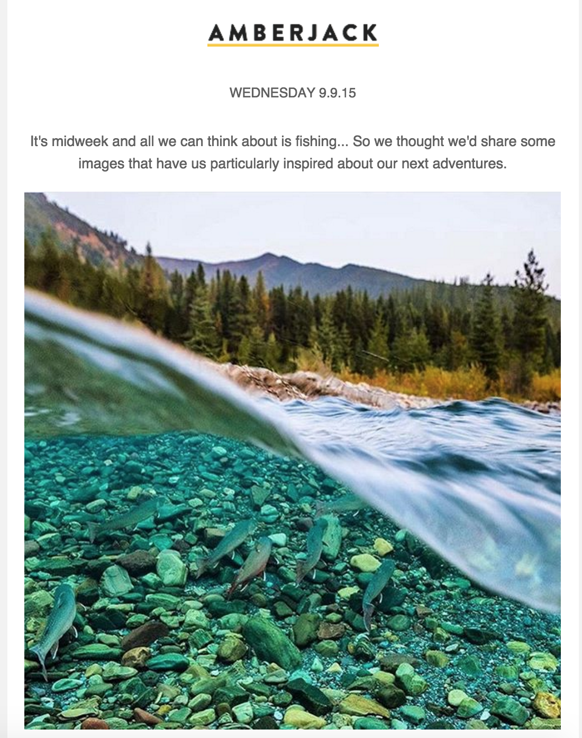
Photo Stream

Slide 23
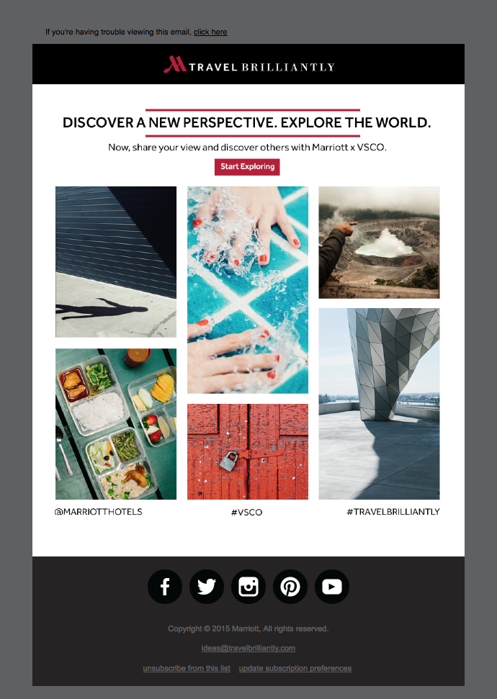
Photo Stream
Marriott + VSCO

Slide 24

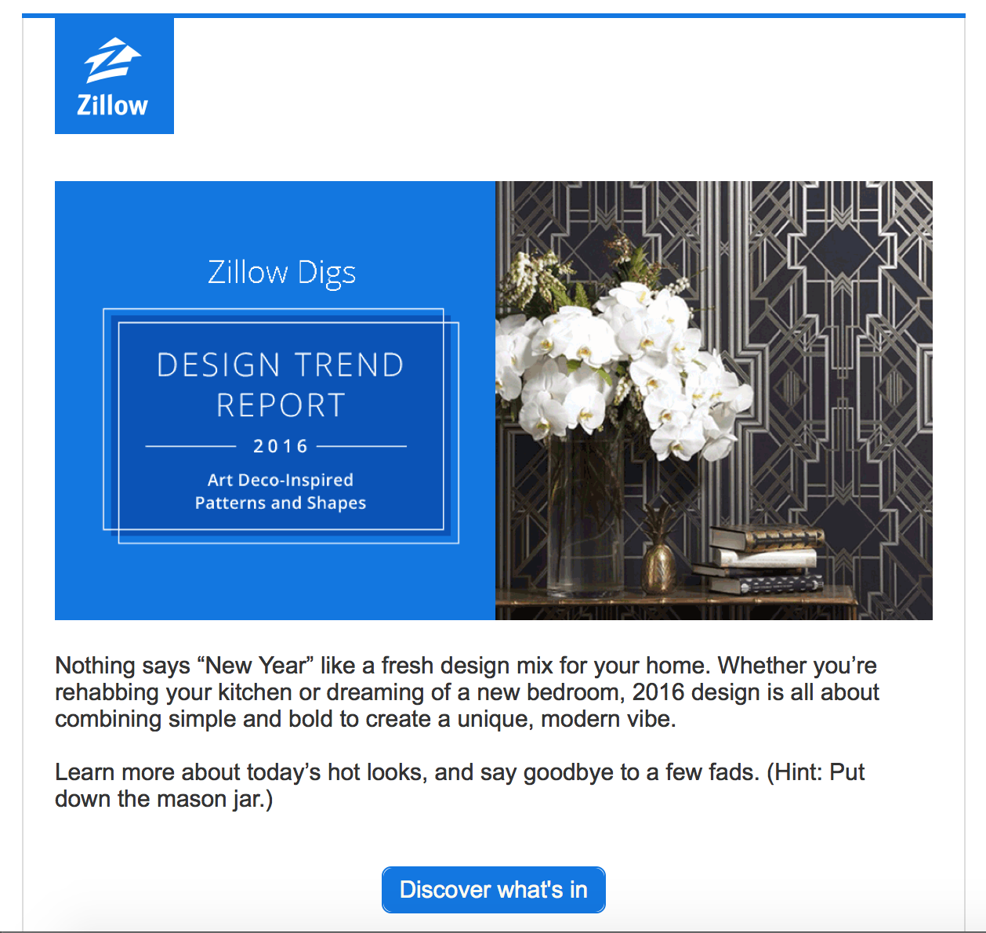
Trends Round-Up

Slide 25
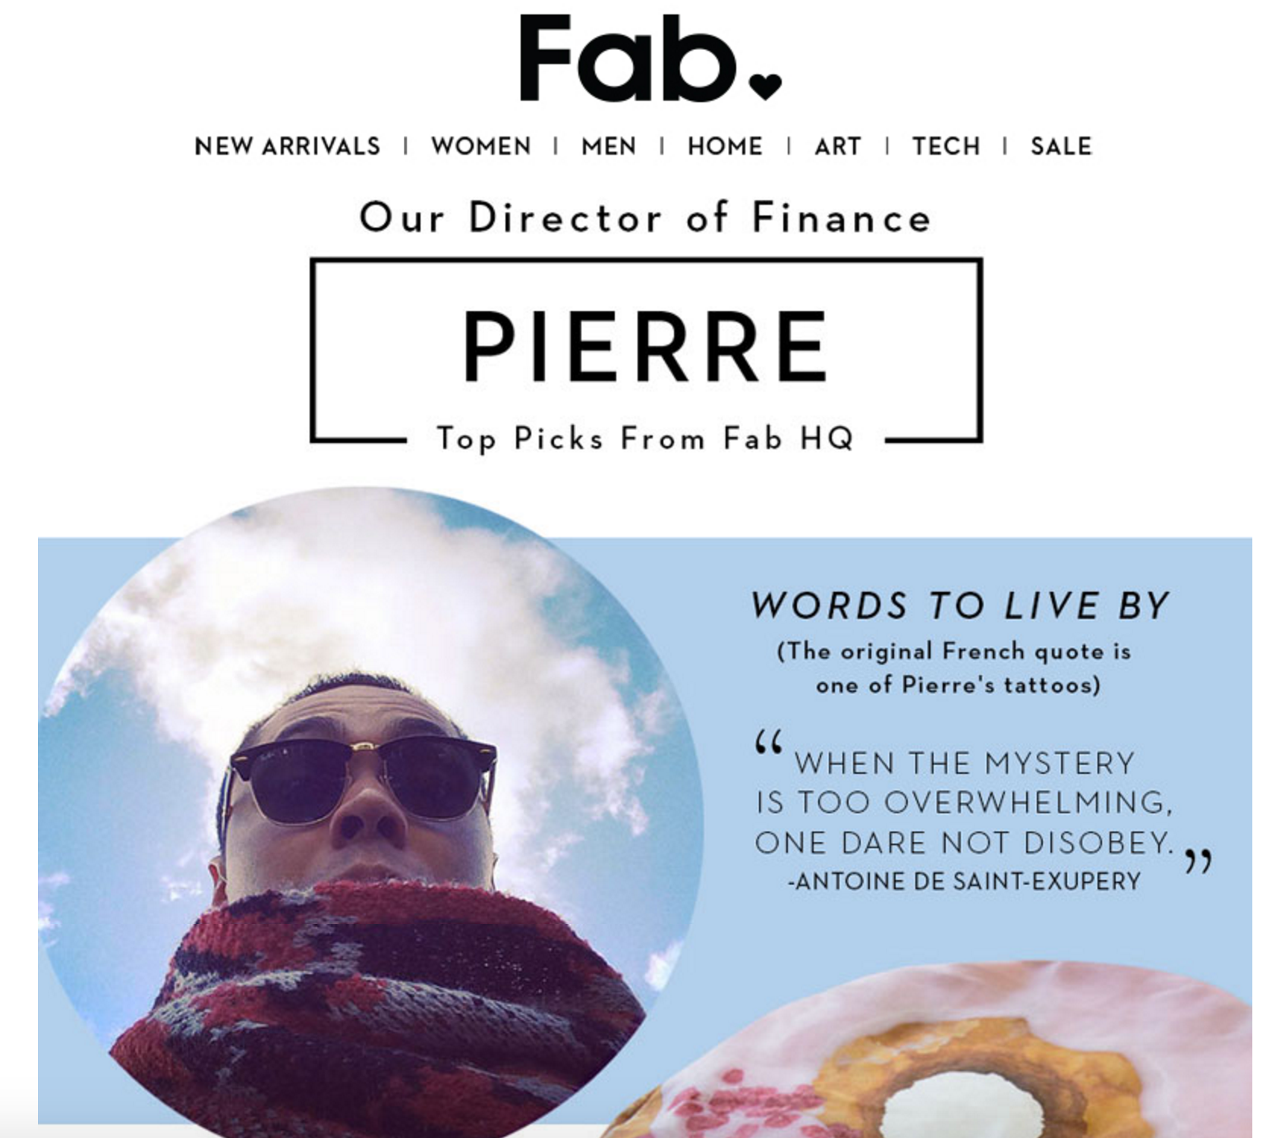
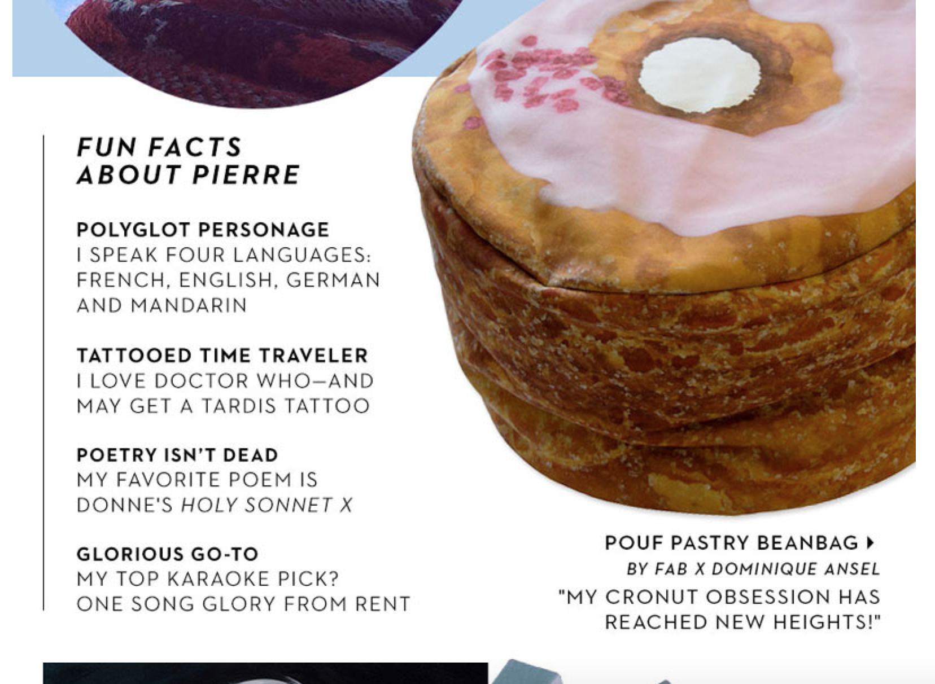
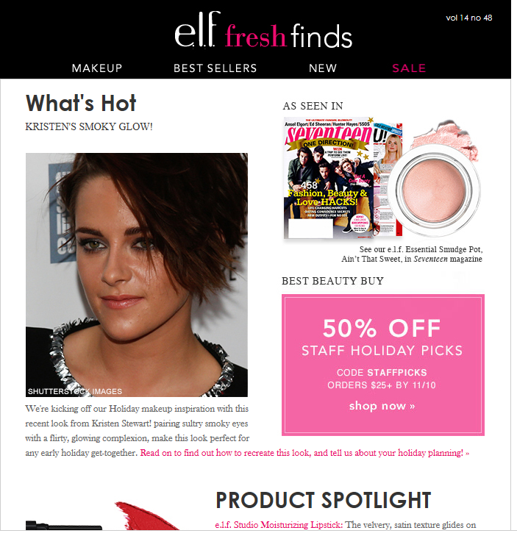
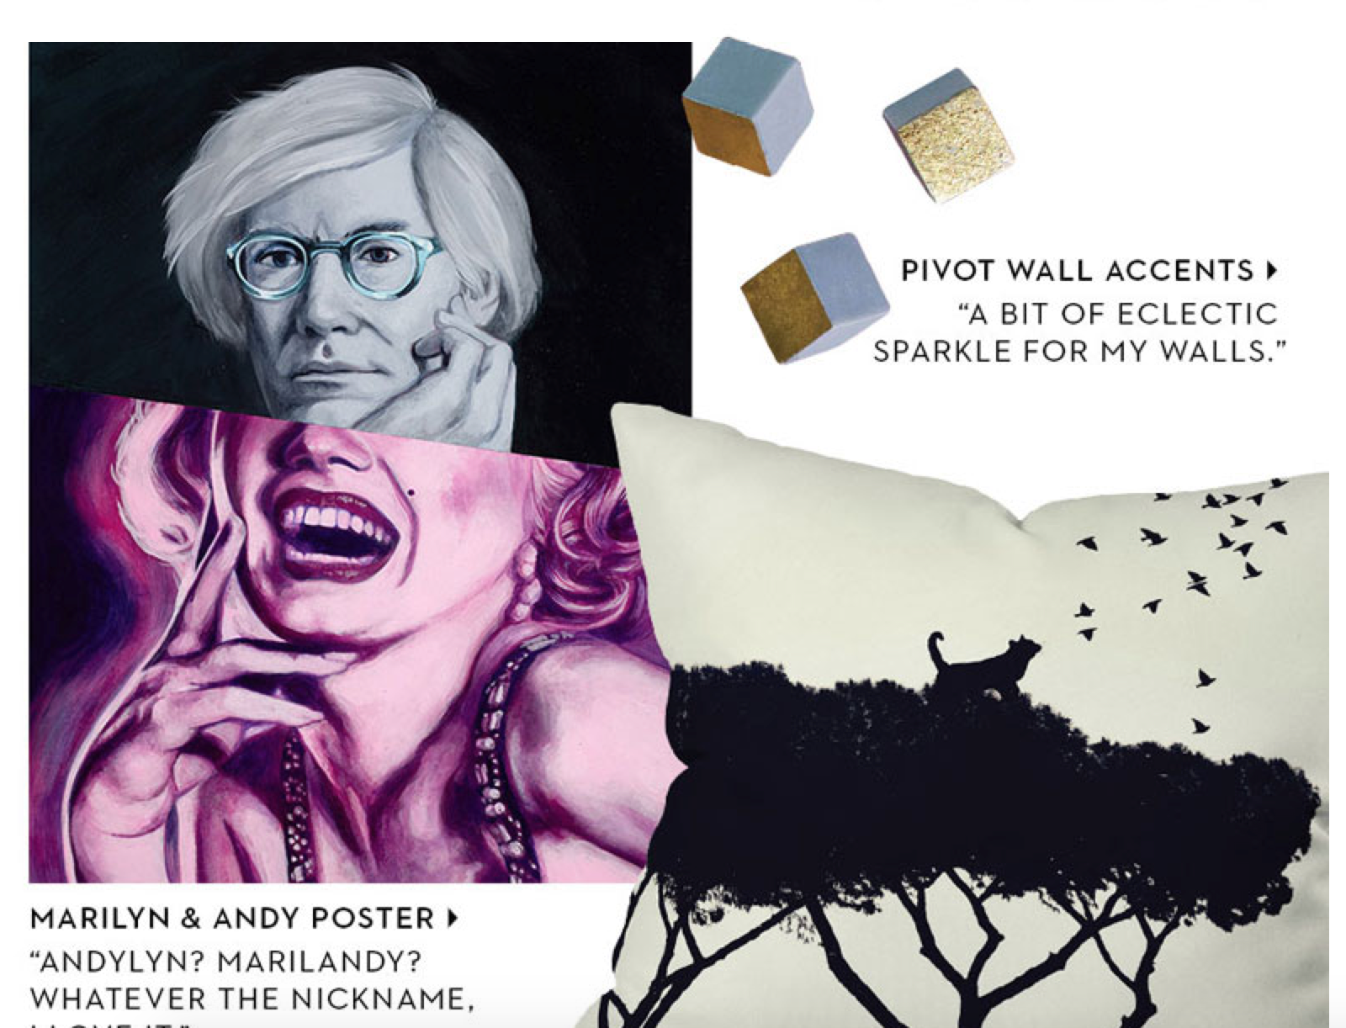

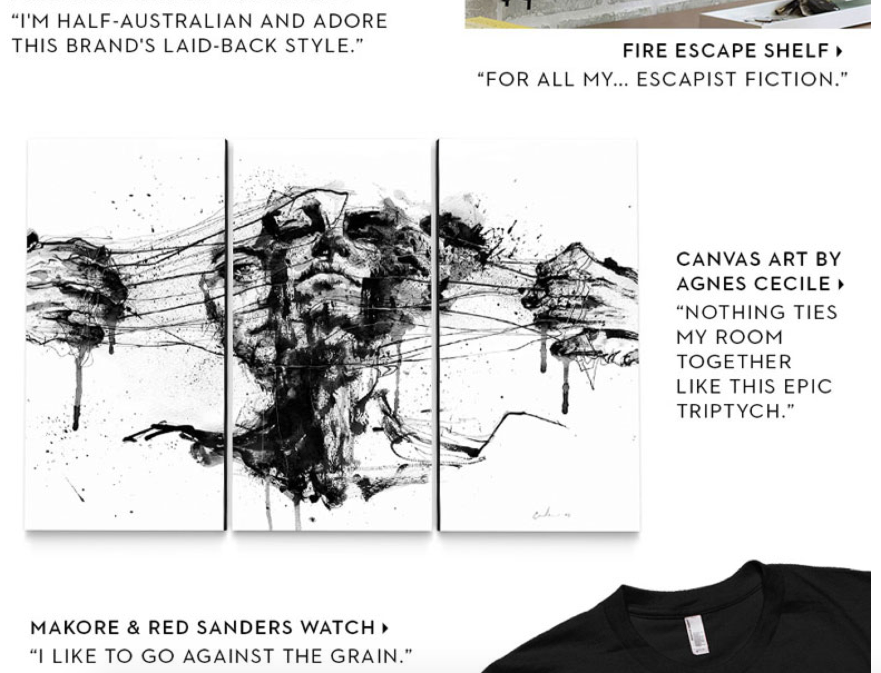
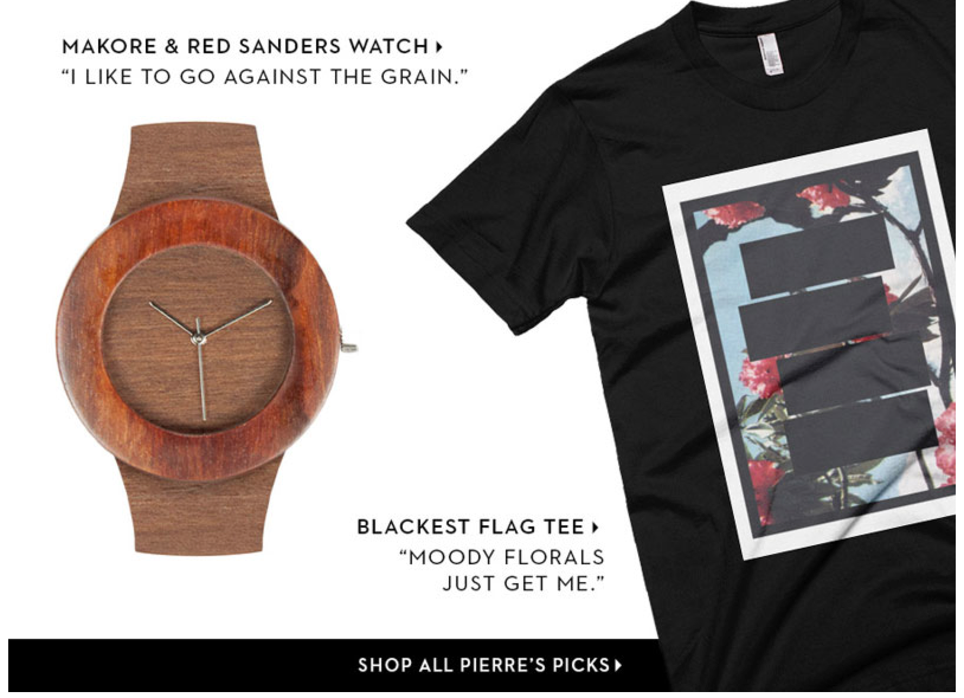
Staff Picks

Slide 26
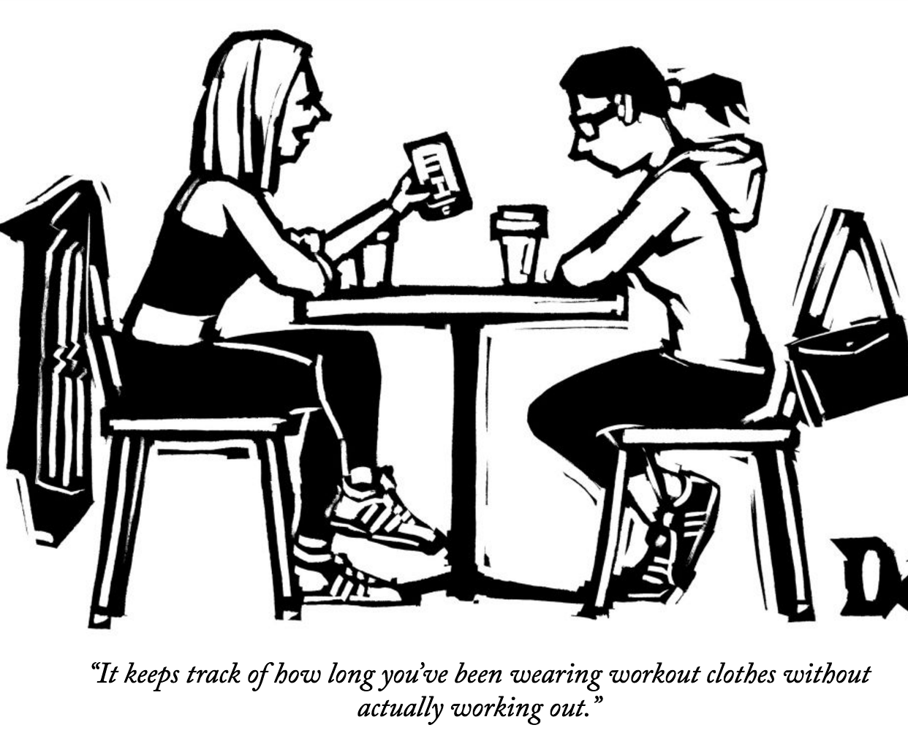
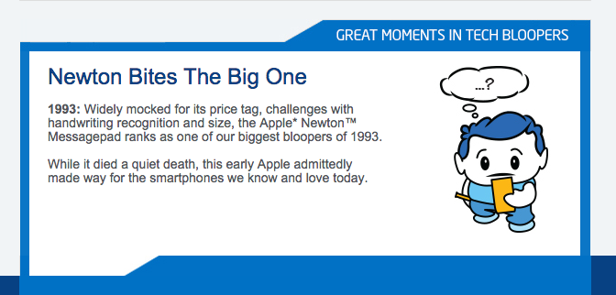
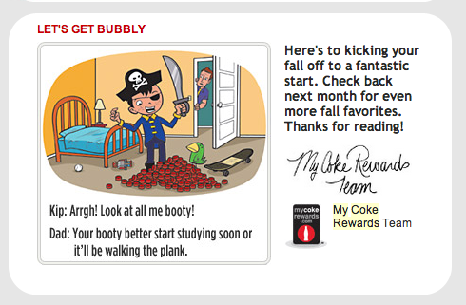
Humor
Great as reoccurring sticky content

Slide 27
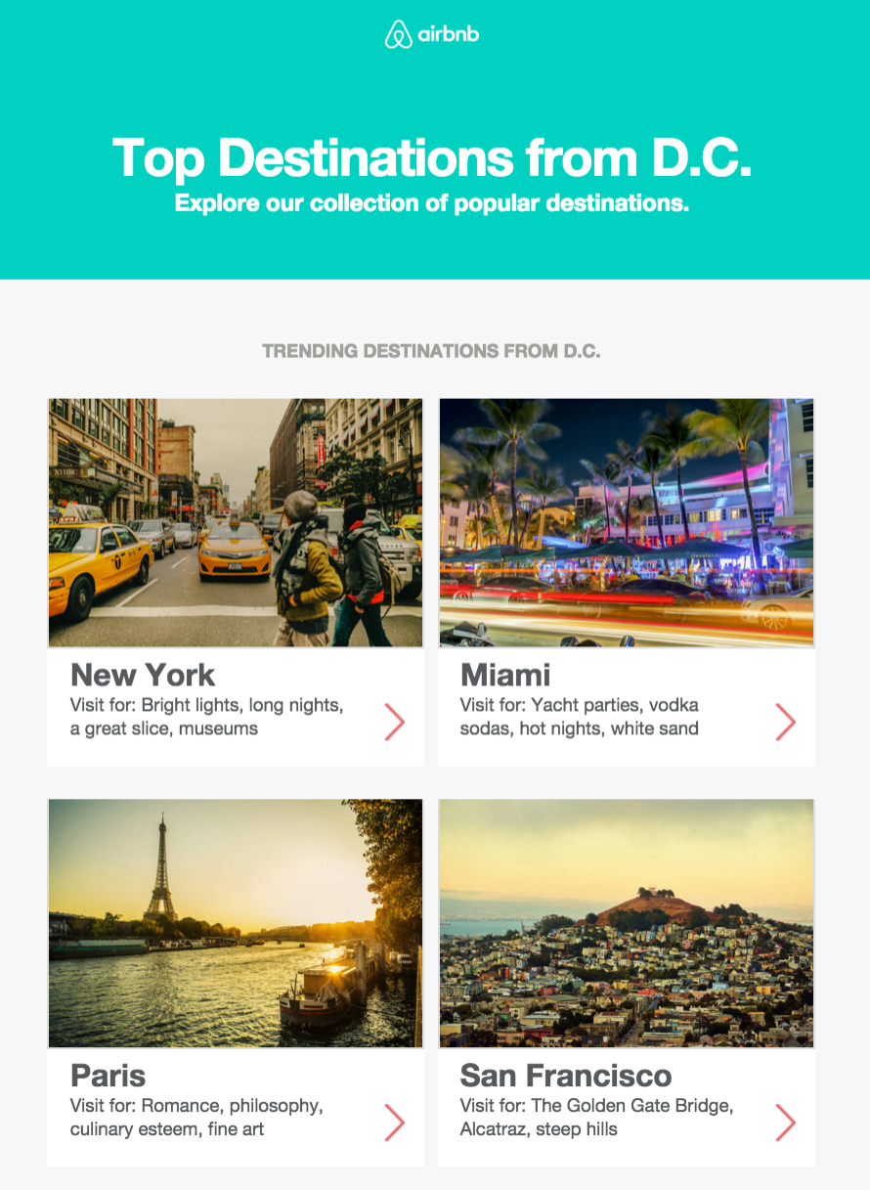
Top Lists & Round-Ups
Most Read Articles
Most Searched Destinations
Most Redeemed Destinations
Top Trending Warm Locales
A Stay in the Life
One City, 3 Ways

Slide 28
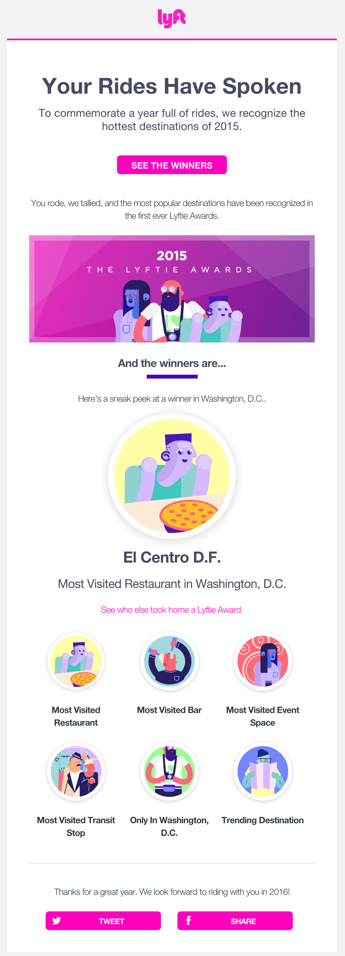

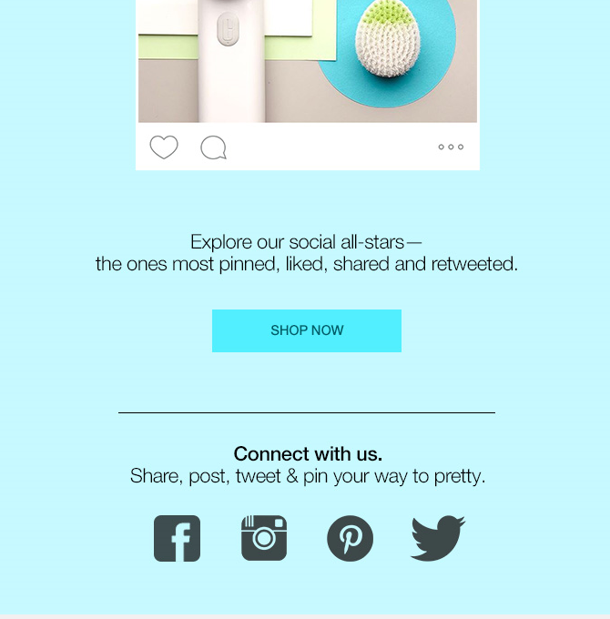
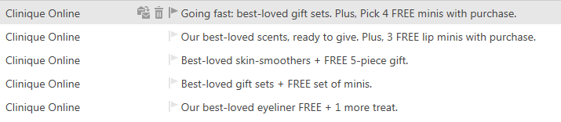
Top Lists

Slide 29
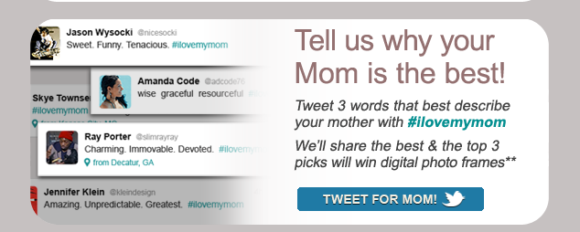
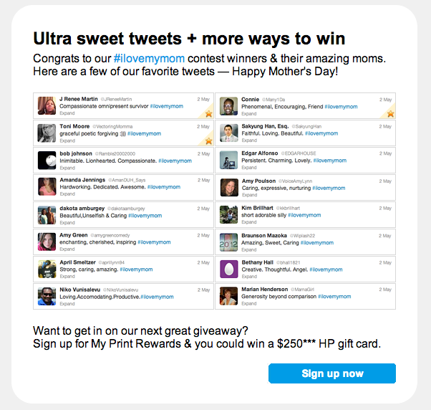
Social: Call & Display
Request input
Display results
Community
Interactive

Slide 30
Current Events/Pop Culture as Themes
Copy & design that connects to topics that will be trending on the email launch date

Slide 31

Current Events/Pop Culture as Themes

Slide 32
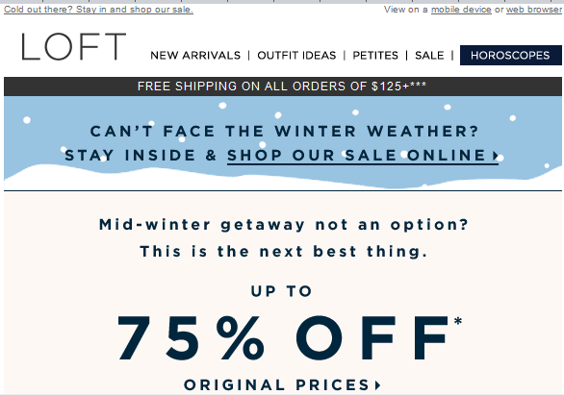

Current Events/Pop Culture as Themes
Sent Jan. 22-23rd

Slide 33
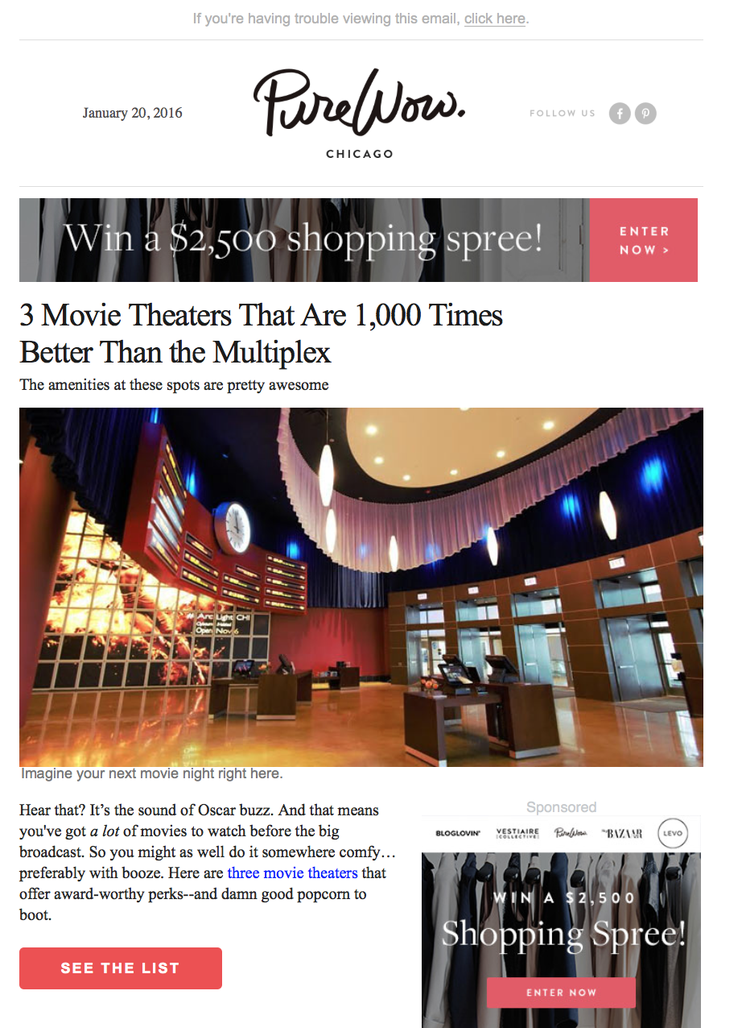
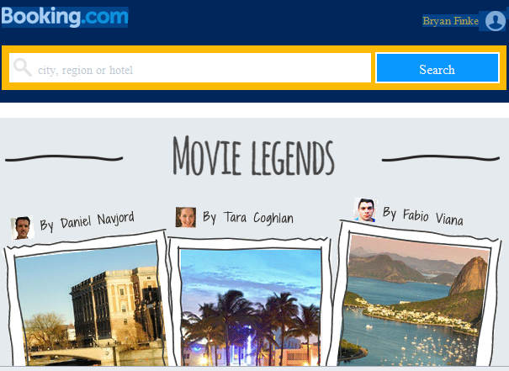
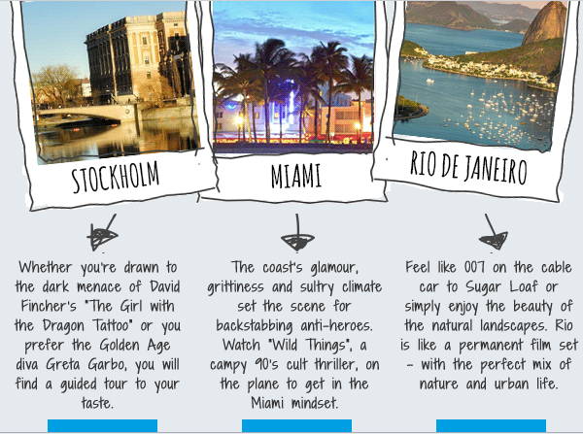
Current Events/Pop Culture as Themes

Slide 34
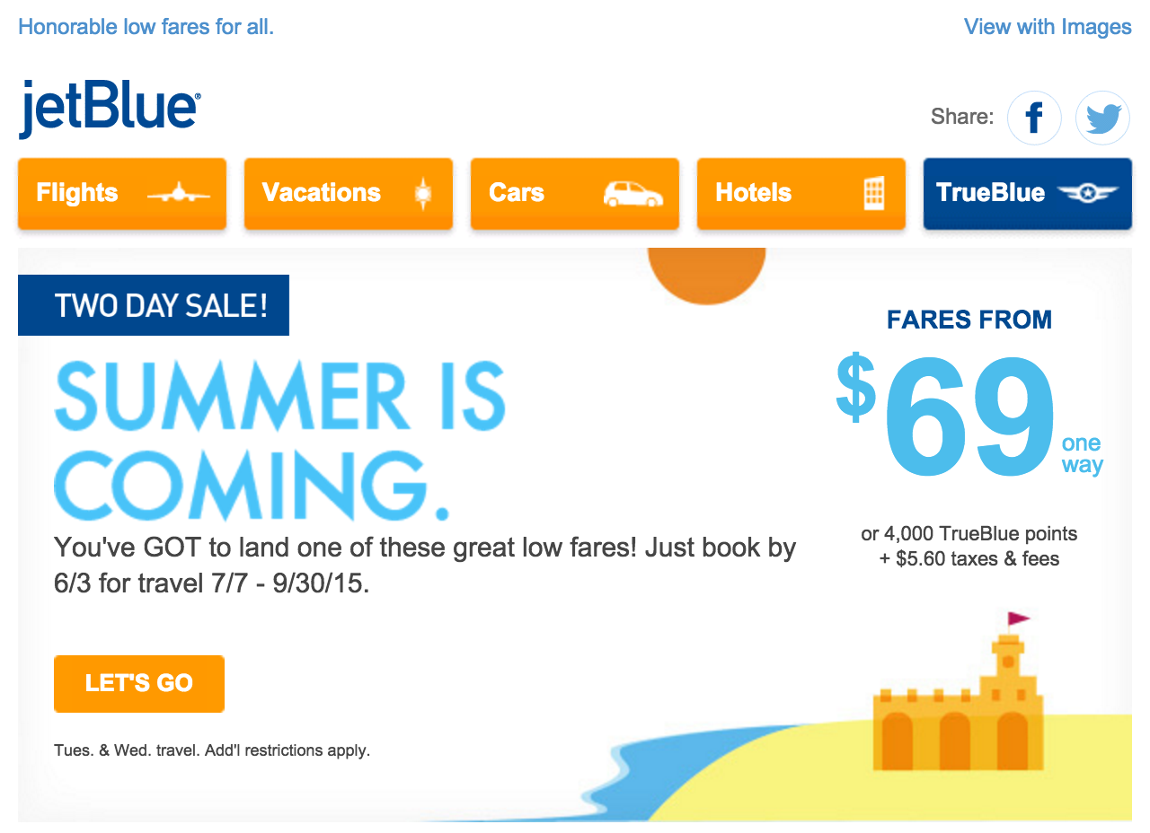
Current Events/Pop Culture as Themes

Slide 35
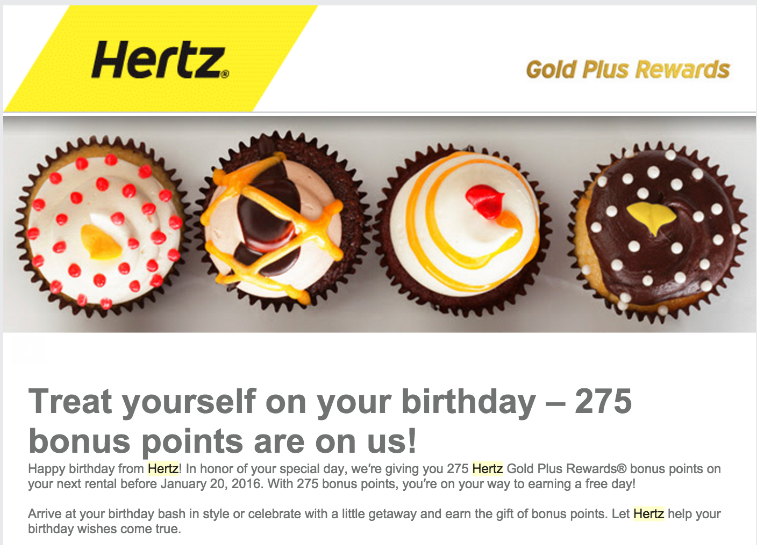
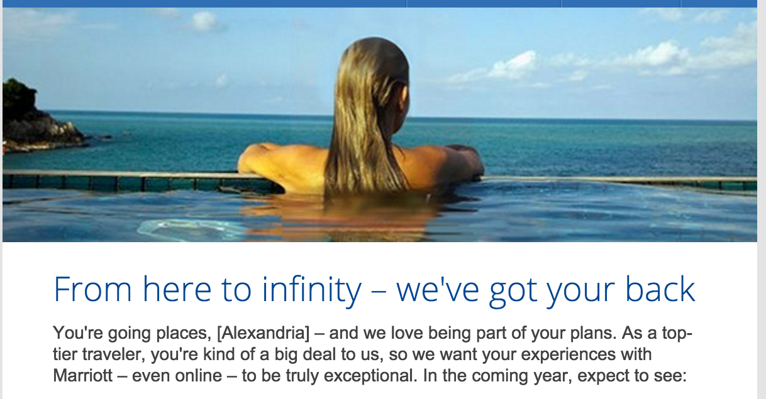
Cohesion – Words & Image
Direct combination of Headlines + Image
As seen in Project Orange “we’ve got your back”

Slide 36

Connected Content
Create an experience with different types of content

Slide 37




Data
Compiled data displayed with infographics & illustration

Slide 38






Personalized Data
Dynamic user data

Slide 39
Thank you

