Slide 1
CALA Monthly
Email Review
Jan 2024
21 March 2023

Slide 2

Meeting Agenda
Performance Summary
Campaign Engagement
  Destination Solo
  Global Local Campaigns
  METT
Testing & Optimization
Actionable Insights

Slide 3
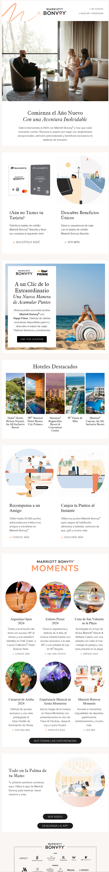
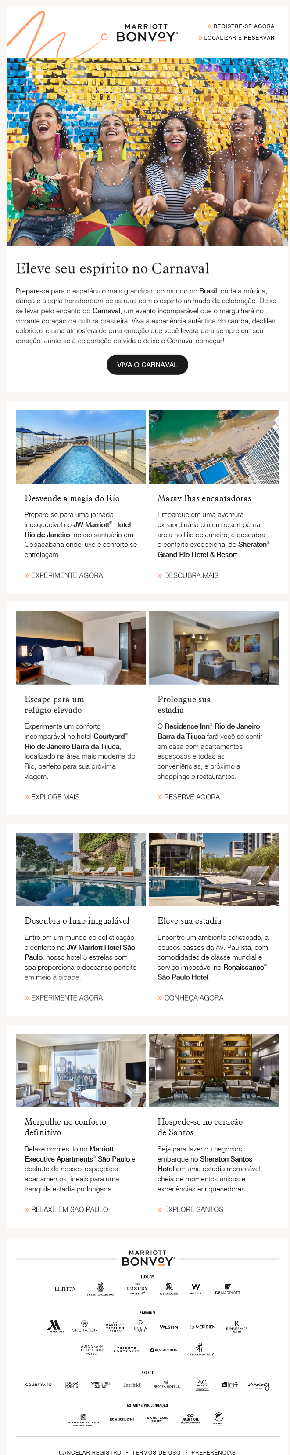

Key Storylines
Jan Loyalty
MBV Moments module
January 2024
5.8M email deliveries in Jan ‘24, generating over 287 bookings and $170.4K in email attributed revenue. Deliveries -23% MoM without high volume campaigns like Dec Buy Points.
  Overall revenues +29% YoY supported by Dest Solo’s higher bookings and revenue MoM & YoY.
  CALA revenue and bookings continue to trend higher MoM despite US properties pulling a revenue majority at 50% of rev to US properties.
While Jan falls short of refreshed engagement goals by approximately -0.4 pts. across each category, Destination Solo generated 0.68% CTR, highest within last 3 months.
Destination Solo’s new Hero treatment featuring cycling circles to highlight properties. This hero gif captured interest from both member & non-member audiences.
Unsub rates +0.06 MoM. Consecutive sends to Portuguese language segment impacted unsub rates.
Aruba METT pulled in 34% of Jan METT revenue, generated by 2 booking. Within MBV Moments module in Loyalty Global/Local, Aruba’s Carnival feature captured the most clicks.
Jan Carnival METT

Slide 4
Monthly Performance Summary

Slide 5
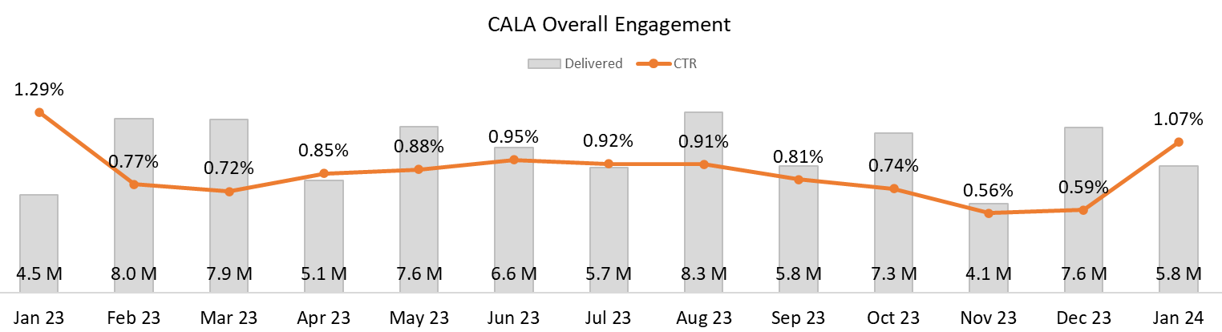
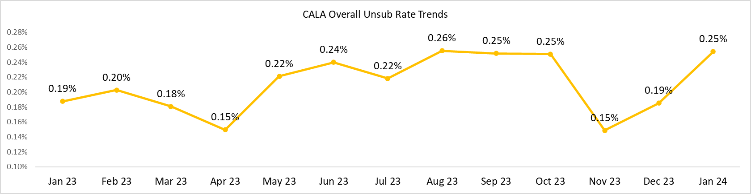
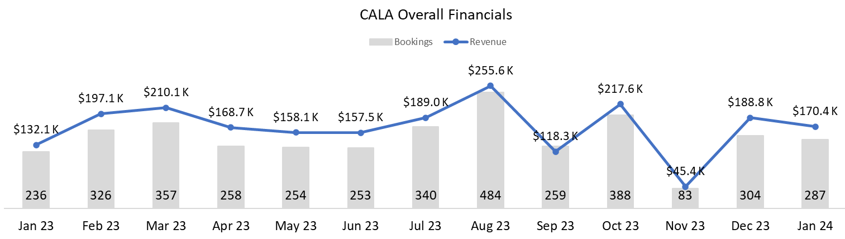
Monthly Performance Summary: Engagement Trends
Bonvoy Jan CTR: 1.2%
January 2024
Deliveries -23% MoM without high volume campaigns like Dec Buy Points. CTR increase impacted by higher click activity and less overall deliveries; higher CTR from Dest Solo and Core MAU.
Post holiday, unsub rates return to Q3’s higher rates within Dest Solo’s Mexico (0.31) & Brazil (0.36%) segments.
Revenues +29% YoY supported by Dest Solo’s higher bookings and revenue MoM & YoY.
Bonvoy Jan Unsub: 0.19%
Notes:
dec Buy Points delivered $735K with $10K

Slide 6
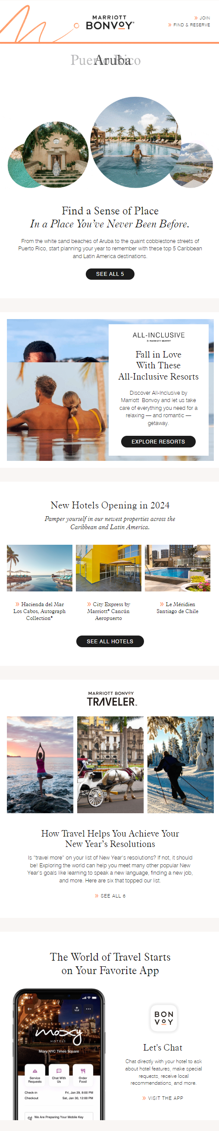

Monthly Performance Summary:
Engagement Goals
Member, Mobile App,
English Version
January 2024
Destination Solo and METT CTR goals reduced to 1% based on prior year engagement trends.
While Jan falls short of revised goals by approximately 0.4 pts. across each category, Dest Solo generated 0.68% CTR, highest within last 3 months.
Notes:
To obtain CALA go to the METT and Dest Solo tabs and update the region form ALL to ‘CALA’

Slide 7
Regional Email Campaign: Destinations Solo

Slide 8
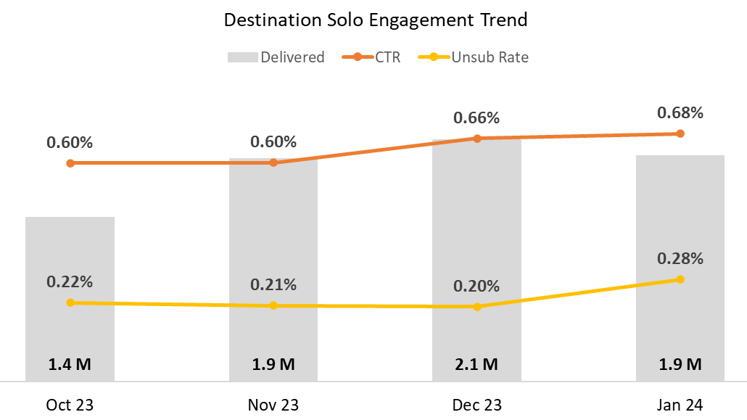
Destination Solo: Performance Summary
January 2024
MoM targeting and engagement steady. Unsub increase by +0.07; above benchmark. Consecutive sends to Portuguese language segment MoM. Monitor unsub engagement for segment (0.36%).
Financial gains primarily from Mexico segment, 40% of Dest Solo’s bookings and revenues.
Notes:
Jan 29
This solo is targeting approximately 2,216,721 members and non-members based on the following criteria:
Members and non-members who reside in United States OR Canada OR CALA with an English language preference who have had one or more stays in the past 36 months in all CALA Countries
Members and non-members with a Spanish language preference who reside in all CALA Countries
Members and non-members with a Spanish language preference who reside in Mexico or the US
Members and non-members with a Portuguese language preference who reside in Brazil
Dec 21
This solo is targeting approximately 2,169,808 members and non-members based on the following criteria:
Members and non-members who reside in United States OR Canada OR CALA with an English language preference who have had one or more stays in the past 36 months in all CALA Countries
Members and non-members with a Spanish language preference who reside in all CALA Countries
Members and non-members with a Spanish language preference who reside in Mexico or the US
Members and non-members with a Portuguese language preference who reside in Brazil

Slide 9
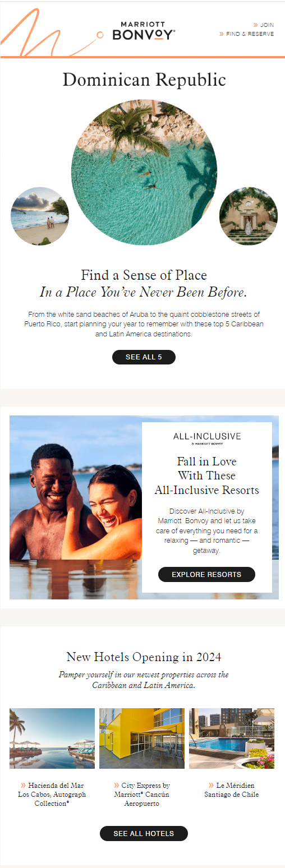
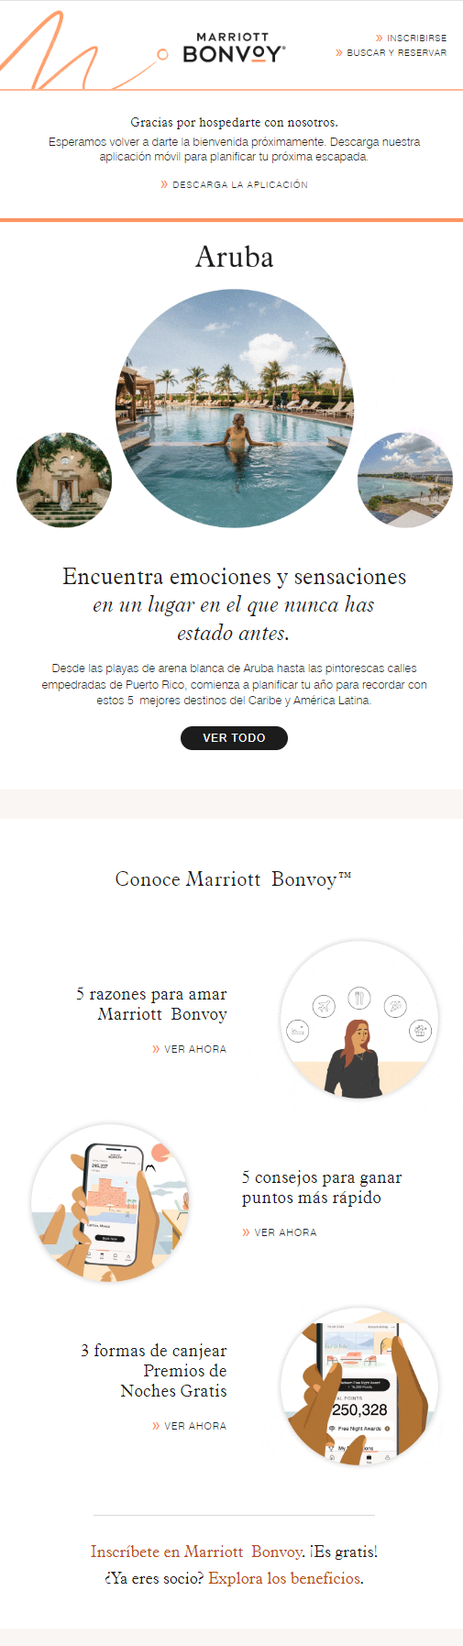
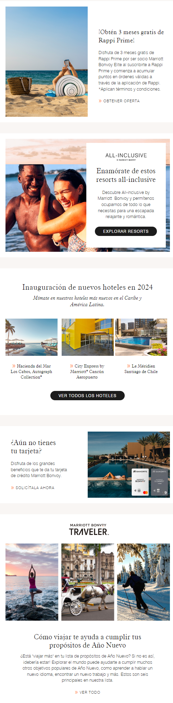
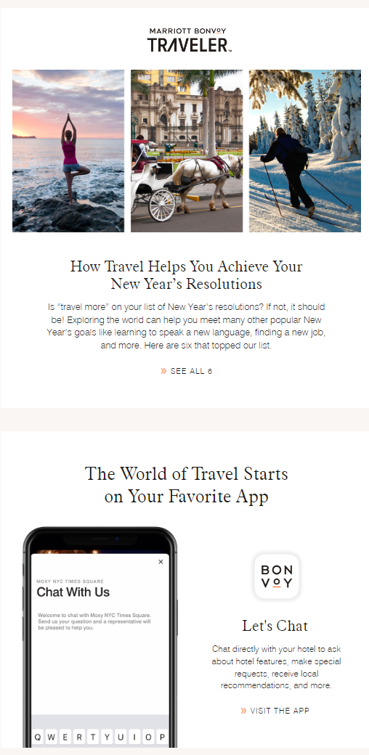

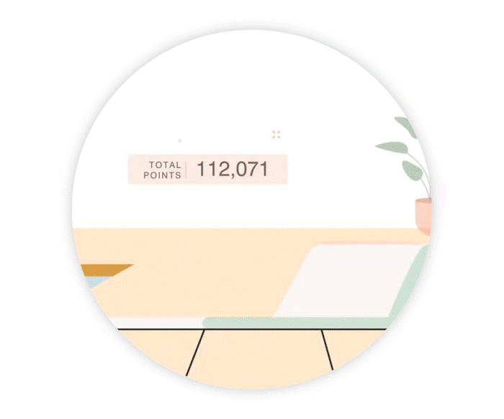
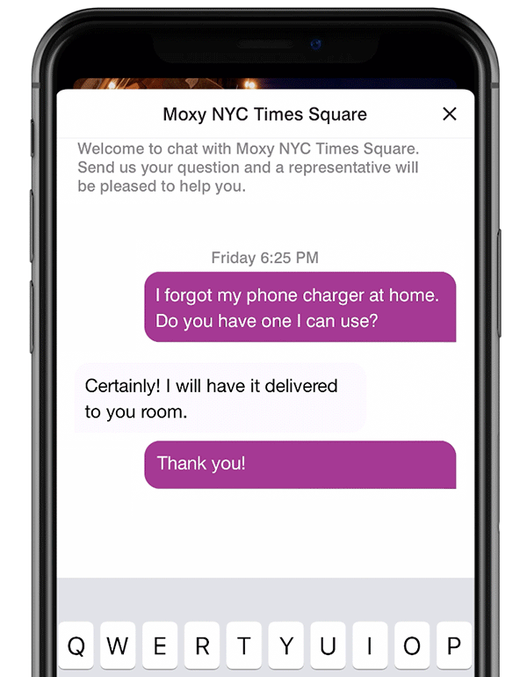

Destination Solo:
Creative Highlights
Member, Mobile App,
English Version
Non-Member, Recent Stay, RAPPI,
Mexico Spanish Version
Deployment Date: January 29th, 2024
Subject Line: [Fname, ]Here's Where to Plan Your Next Tropical Getaway
PH: Also Inside: New 2024 hotels, romantic all-inclusive resorts, and more.
New hero treatment featuring cycling circles to highlight properties.
New Member Perks Module to promote non-member enrollments.
1st month featuring RAPPI partnership in creative.
3rd month of featuring “Let’s Chat” mobile creative.
Notes:
Opportunity /issue – didn’t have 3 dynamic versions but only 1 creative included/deployed – not in MT, only made it to the content outline
Campaign key 2077412
The CALA January Solo will deploy on Monday, January 29th at 9am EST. This campaign highlights regional and local offers in the CALA markets to help individuals discover and plan the perfect getaway. This campaign will be deployed using TLP (Tactic Level Prioritization).
Jan is the first month of the get to know member module
This solo is targeting approximately 2,216,721 members and non-members based on the following criteria:
Members and non-members who reside in United States OR Canada OR CALA with an English language preference who have had one or more stays in the past 36 months in all CALA Countries
Members and non-members with a Spanish language preference who reside in all CALA Countries
Members and non-members with a Spanish language preference who reside in Mexico or the US
Members and non-members with a Portuguese language preference who reside in Brazil

Slide 10
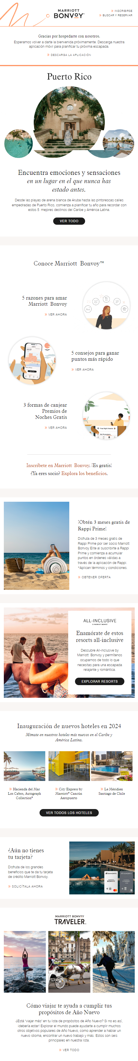
Destination Solo: Click Map
Member Version
Non- Member Version
January 2024
1
The new Hero treatment grabbed the interest of both member & non-member audiences.
The Member Perks module that was sent to non-members to encourage enrollments had a high engagement rate second to the hero.
All-Inclusive module didn’t attract non-members as well as it did members.
  This module was lower in the creative for non-members.
New Hotels was the second highest clicked overall.
  “See All Hotels CTA” was between the 1-2nd most clicked within the module. Featuring a generic new hotel module may help drive even more of a lift to CALA properties.
1
2
3
2
January ‘24 Destination Solo | Members | Non-Members | Grand Total
Header | 11.5% | 11.8% | 11.5%
Recent Stay | 0.8% | 1.0% | 0.9%
Hero | 35.4% | 28.3% | 33.5%
Member Perks | -- | 16.8% | 4.5%
RAPPI | 2.2% | 2.4% | 2.2%
All-Inclusive | 18.7% | 6.3% | 15.4%
New Hotels | 16.8% | 14.0% | 16.1%
City Express Cancun Aeropuerto | 5.5% | 4.0% | 5.1%
Hacienda del Mar Los Cabos | 2.4% | 3.4% | 2.7%
Hotel Plaza Santiago | 3.3% | 3.3% | 3.3%
See all hotels CTA | 5.5% | 3.4% | 5.0%
Cobrand | 1.3% | 0.0% | 1.0%
Traveler | 2.2% | 3.2% | 2.5%
Mobile App | 2.4% | 2.8% | 2.5%
Footer | 8.7% | 13.3% | 10.0%
Total Clicks | 14,595 | 5,339 | 19,934
3
Notes:
Recommend lookback on all-inclusive module to review possible creative or module fatigue
Catch all CTA might have grabbed attention – maybe a general message

Slide 11
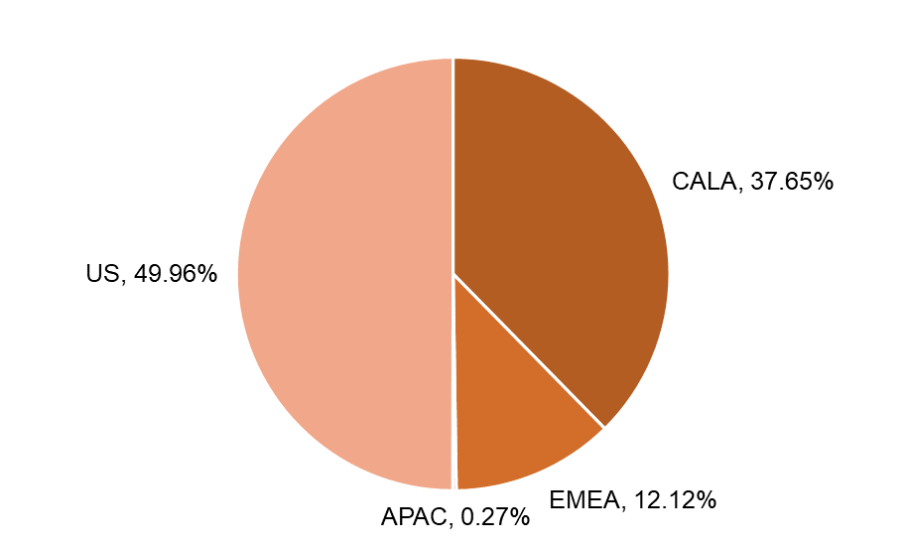
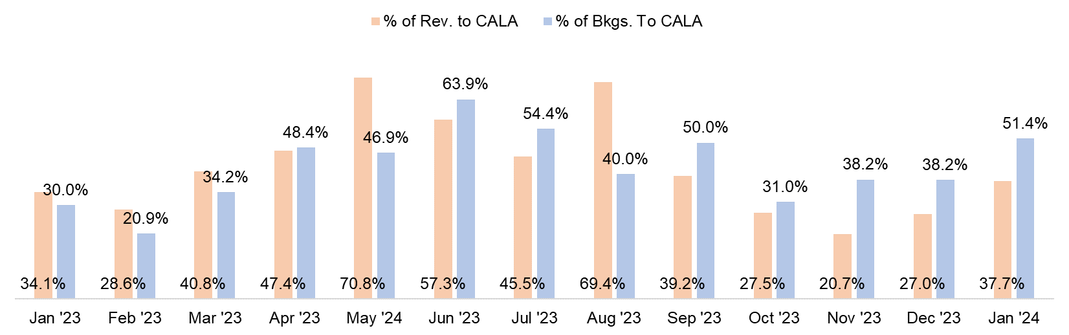
Destinations Solo: CALA Financial Contribution
January 2024
% of Revenue by Region
CALA Revenue and Bookings trending higher MoM.
Revenue and Bookings % towards CALA properties are up YoY.
US properties grabbed most of the revenue share this month at 50% of rev to US properties.
% of Solo Revenue to CALA Properties
% of Rev. to CALA:
+10.6 pts. MoM
+3.6 pts. YoY
% of Bkgs. To CALA:
+13.2 pts. MoM
+21.4 pts. YoY

Slide 12
Destinations Solo:
Property Summary
Brands by Region Jan '24 | Bookings | Roomnights | Revenue | % of Rev. | MoM
CALA | 19 | 37 | $5,519 | 37.7% | +10.6 pts.
Renaissance | 2 | 6 | $2,717
City Express | 9 | 13 | $824
Sheraton | 1 | 4 | $700
MHRS | 3 | 5 | $678
Residence Inn | 1 | 5 | $215
Westin | 1 | 2 | $170
Courtyard | 1 | 1 | $110
Luxury Collection | 1 | 1 | $105
US | 15 | 32 | $7,324 | 50.0% | +17.8 pts.
Westin | 3 | 8 | $2,932
MHRS | 1 | 5 | $1,245
MVCI | 2 | 6 | $1,036
Residence Inn | 1 | 2 | $770
Renaissance | 1 | 1 | $392
Autograph Collection | 1 | 1 | $270
Aloft | 1 | 3 | $240
Four Points | 2 | 2 | $203
SpringHill Suites | 1 | 1 | $126
Sheraton | 1 | 2 | $74
Fairfield Inn | 1 | 1 | $36
EMEA | 2 | 5 | $1,776 | 12.1% | -25.6 pts.
Luxury Collection | 1 | 2 | $1,273
Courtyard | 1 | 3 | $503
Westin | 2 | 3 | $371
APAC | 1 | 1 | $39 | 0.3% | -1.5 pts.
Westin | 1 | 1 | $39
Grand Total | 37 | 75 | $14,659
January 2024
City Express, which attributes to 47% of CALA bookings, continues to be a high booking driver MoM.
Renaissance Wind Creek Curacao Resort was the top driver for revenue towards CALA properties in Jan ’24
  Revenue likely driven from link in hero which takes the reader to a Caribbean destination search within Marriott.com.
Majority of revenue for Jan ‘24 is driving from the header of the email which may be leading audiences to book US properties.
Including Traveler content that focuses primarily on CALA may help drive more revenue to CALA properties.
Notes:
This property is near a cruise port “Curacao Cruise Terminal” which may have drove bookings. Including a Cruise With Points module to encourage cruises in CALA may help drive more revenue to CALA properties.
Kur uh sau

Slide 13
Regional Email Campaign: Loyalty Global/Local

Slide 14



Loyalty Global/Local:
Creative Highlights
Member, Mobile App,
Spanish
January 2024
Deployment Date: January 15th, 2024
Subject Line: Comienza el año con Marriott Bonvoy, tu compañero de aventuras
Subject Line (English): Start the year with Marriott Bonvoy, your adventure companion
Cobrand Card module (Mexico) featured animation on how to elevate travel with unique card benefits.
RAPPI module encouraging Mexico and Colombia segments to join Marriott Bonvoy and RAPPI accounts together.
MBV Moments including the Argentina Open, Estereo Picnic, Valentine’s Dinner, Monterrey Concerts, Aruba Carnival, and animation video to view more Moments.
Notes:
Cobrand: Discover Unique Benefits Elevate your travel experience with credit card Marriott Bonvoy Banorte.
As we continue with the activation of CALA member communication strategy through Global Local Op Model, the CALA Loyalty January Global/Local will deploy on Monday, January 15th at 10:00 AM ET.
This campaign highlights Loyalty information,
Launch details
Deployment Dates:
ES: Monday, January 15th
Targeting audience: Active members in CALA with Spanish Language preference.
Audience count/size:
849,535 counts
Languages Supported: Spanish
Key campaign highlights:
Areas Supported:
Mexico
CASA
CARAI
Content:
Hotels
Barranquilla Marriott Hotel
Santa Marta Marriott® Resort Playa Dormida
JW® Marriott Hotel Bogota
Los Sueños Marriott® Ocean & Golf Resort
The Ritz-Carlton®, Santiago
Delta® Hotels Riviera Nayarit, An All-Inclusive Resort
JW® Marriott Hotel Mexico City Polanco
Sheraton® Buganvilias Resort & Convention Center
W® Punta de Mita
Marriott® Cancun, An All-Inclusive Resort
Cobrand Card (Mexico Only)
RAPPI Partnership (Mexico and Colombia Only)
Moments
Argentina Open
Estereo Picnic
Aruba Marriott Resort & Stellaris Casino – Valentines Dinner
Aruba Carnival
Monterrey Concerts
Marriott Bonvoy Moments general information
APP

Slide 15
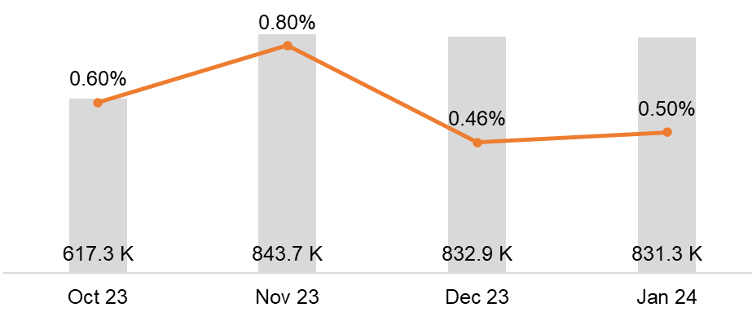
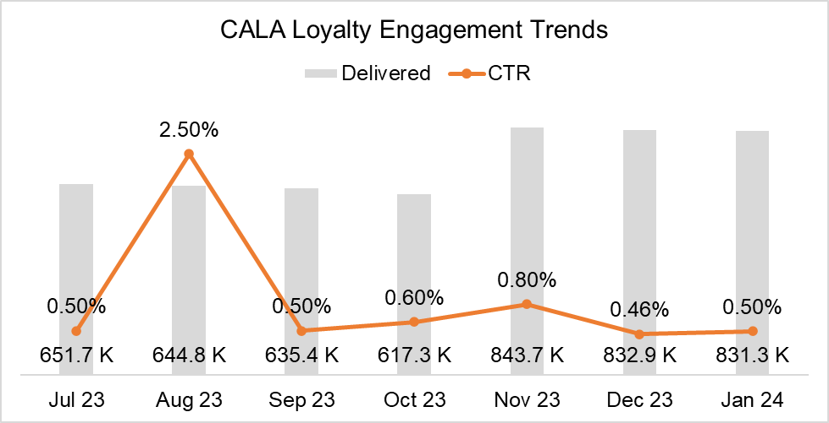
Loyalty Global/Local:
Content Performance
Member, Mobile App,
Spanish
January 2024
Jan targeting criteria remained consistent with Q4 (CALA active, Spanish language preference).
+0.04 pts. increase in CTR supported by top engagements within (1) 5-pack, (2) Cobrand Card, and (3) MBV Moments.
Like Nov and Dec, Jan featured a non-CTA hero. In turn, secondary module performance captured above the fold clicks.
3
2
Loyalty Engagement Trend
1
PCM data used for ‘23 Loyalty data. Jan ’24 data loaded to Contract History
Notes:
For example, Nov non-CTA allowed for secondary module, RAPPI to reach 3.5% of unique clicks. (it’s typically mid to high 2%)
Animated gifs were featured within cobrand, educational video and app modules.
Unsub 0.13 $1000 rev
-- Same target as Dec
Last month had a poll, cascading circles for new hotels, mbv moments
Notate the Aug theme causing the spike
As we continue with the activation of CALA member communication strategy through Global Local Op Model, the CALA Loyalty January Global/Local will deploy on Monday, January 15th at 10:00 AM ET.
This campaign highlights Loyalty information,
Launch details
Deployment Dates:
ES: Monday, January 15th
Targeting audience: Active members in CALA with Spanish Language preference.
Audience count/size:
849,535 counts
Languages Supported: Spanish
Key campaign highlights:
Areas Supported:
Mexico
CASA
CARAI
Content:
Hotels
Barranquilla Marriott Hotel
Santa Marta Marriott® Resort Playa Dormida
JW® Marriott Hotel Bogota
Los Sueños Marriott® Ocean & Golf Resort
The Ritz-Carlton®, Santiago
Delta® Hotels Riviera Nayarit, An All-Inclusive Resort
JW® Marriott Hotel Mexico City Polanco
Sheraton® Buganvilias Resort & Convention Center
W® Punta de Mita
Marriott® Cancun, An All-Inclusive Resort
Cobrand Card (Mexico Only)
RAPPI Partnership (Mexico and Colombia Only)
Moments
Argentina Open
Estereo Picnic
Aruba Marriott Resort & Stellaris Casino – Valentines Dinner
Aruba Carnival
Monterrey Concerts
Marriott Bonvoy Moments general information
APP
Personalization efforts:
First Name is being used in the subject line and email copy to improve email engagement.
We are sending this emails using STO (Send Time Optimization).

Slide 16
CALA Loyalty Global/Local: Content Performance
Member, Mobile App,
English Version
January 2024
Educational Videos: 5%
5-pack continues at #1 spot when featured, with 35.6% of total unique clicks. Delta Riviera Nayarit (MX) and JW Bogota (CALA) were the top two clicked destinations within regional versioning.
Cobrand module generated most click engagement within the ‘Discover Unique Benefits’ which included the Cobrand video.
Obtain first click sooner using CTA within hero. If using an editorial approach in hero and no CTA featured, consider reducing hero’s size to support secondary module’s CTA performance.
Produce RAPPI content to demonstrate ‘how to’ link accounts and ‘how to’ order and earn to support click engagements. Set soft goal of 5% of unique clicks within RAPPI module.
2
Cobrand: 25.4%
2,243 unique clicks
CALA Jan '24 Loyalty | % of Clicks
Header | 18.2%
Cobrand (Mexico Only) | 25.4%
RAPPI (Mexico & Colombia Only) | 2.8%
Featured Hotels 5-pack | 35.6%
Educational Videos | 4.9%
Moments | 7.1%
Mobile App | 1.3%
Header | 4.8%
Total # of Clicks | 8,824
3
RAPPI: 2.8%
Columbia: 65 unique clicks
Mexico: 180 unique clicks
Moments:7.1%
Aruba: 147 unique clicks
Tennis: 115 unique clicks
1
Featured Hotels: 35.6%
CALA: 2,532 unique clicks
MX: 609 unique clicks
App: 1.3%
Notes:
(Oct’s point redemption hero, 12% of clicks; Nov 6-pack hero; Dec non-CTA hero)
-- Same target as Dec
Last month had a poll, cascading circles for new hotels, mbv moments
Notate the Aug theme causing the spike
As we continue with the activation of CALA member communication strategy through Global Local Op Model, the CALA Loyalty January Global/Local will deploy on Monday, January 15th at 10:00 AM ET.
This campaign highlights Loyalty information,
Launch details
Deployment Dates:
ES: Monday, January 15th
Targeting audience: Active members in CALA with Spanish Language preference.
Audience count/size:
849,535 counts
Languages Supported: Spanish
Key campaign highlights:
Areas Supported:
Mexico
CASA
CARAI
Content:
Hotels
Barranquilla Marriott Hotel
Santa Marta Marriott® Resort Playa Dormida
JW® Marriott Hotel Bogota
Los Sueños Marriott® Ocean & Golf Resort
The Ritz-Carlton®, Santiago
Delta® Hotels Riviera Nayarit, An All-Inclusive Resort
JW® Marriott Hotel Mexico City Polanco
Sheraton® Buganvilias Resort & Convention Center
W® Punta de Mita
Marriott® Cancun, An All-Inclusive Resort
Cobrand Card (Mexico Only)
RAPPI Partnership (Mexico and Colombia Only)
Moments
Argentina Open
Estereo Picnic
Aruba Marriott Resort & Stellaris Casino – Valentines Dinner
Aruba Carnival
Monterrey Concerts
Marriott Bonvoy Moments general information
APP
Personalization efforts:
First Name is being used in the subject line and email copy to improve email engagement.
We are sending this emails using STO (Send Time Optimization).

Slide 17
Regional Email Campaign: Project Silk

Slide 18
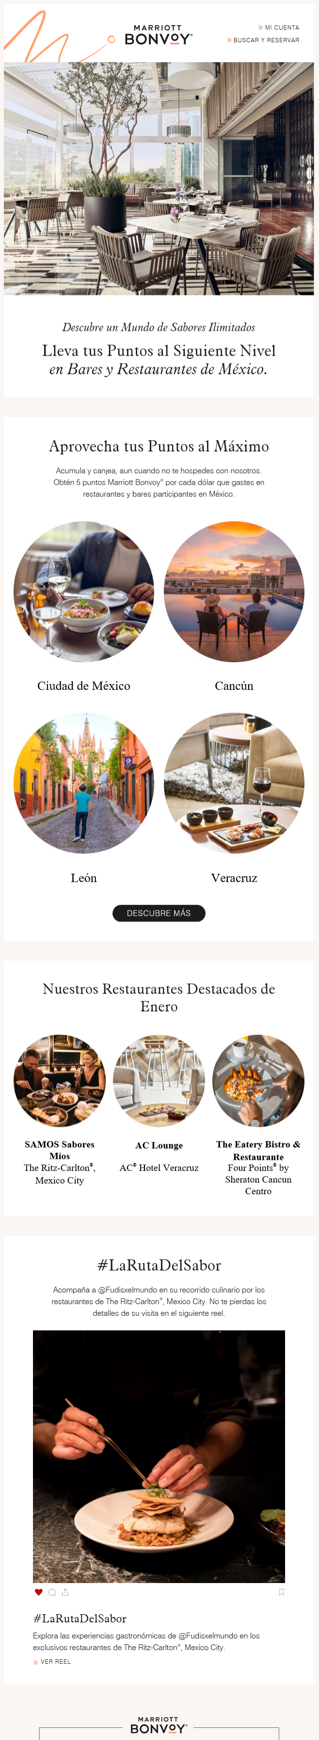
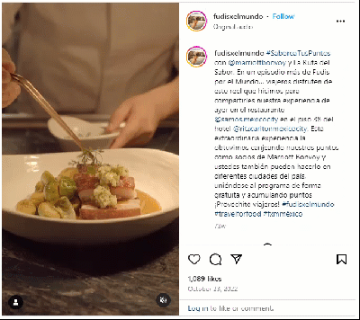
CALA Project Silk:
Creative Highlights
Member, Mexico,
Spanish
January 2024
Deployment Date: January 22nd, 2024
Subject Line: Acumula y Canjea tus Puntos Marriott Bonvoy en los Mejores Bares y Restaurantes de México
Subject Line (English): Accumulate and Redeem your Marriott Bonvoy Points in the Best Bars and Restaurants in Mexico
Leon, Cancun, Mexico City and Veracruz destinations highlighted.
Participating Project Silk Program restaurants featured within destinations highlighted above, to drive regional point activation.
Social Media F&B Influencers module linking out to Instagram.
Notes:
--Campaign Key: 49874230
--Was called F&B in PCM but in LA was called Silk – Campaign Key
The CALA Project Silk January Global/Local will deploy on Monday, January 22nd at 10 AM ET. This campaign highlighted CALA Project Silk program and our restaurants and bars participating in Mexico. We conducted STO (Scheduled Time Optimization) in this deployment.
This message deployed to members based on the following criteria:
LAUNCH DETAILS:
Campaign Theme: Project Silk Program (Mexico Only)
Campaign Objective: Drive points activation with in-region restaurants and bars offerings.
Deployment date: Monday, January 22nd .
Targeting audience: Active members in Mexico
Audience Size:
431,075 members who reside in Mexico with a Spanish language preference
Languages Supported: Spanish
KEY CAMPAIGN HIGHLIGHTS:
Areas Supported:
Mexico
Destinations Highlighted:
Leon
Cancun
Ciudad de Mexico
Veracruz
Featured restaurants:
SAMOS Sabores Míos – The Ritz Carlton, Mexico City
AC Lounge – AC Hotel Veracruz
The Eatery Bistro & Restaurante – Four Points by Sheraton Cancun Centro
Additional information:
Instagram Influencers F&B
Personalization:
No personalization

Slide 19
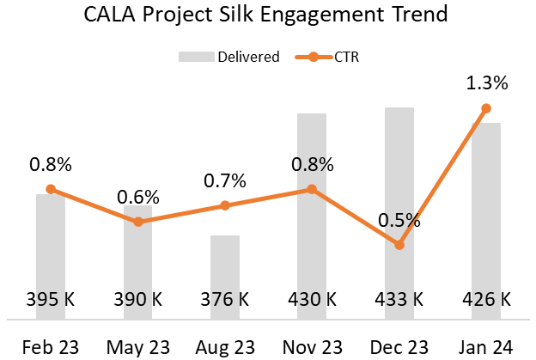
CALA Project Silk:
Content Performance
Member, Mexico,
Spanish
January 2024
2
Featured Destinations module continues to obtain the largest percent of unique clicks. +0.8 pts. increase in CTR MoM.
Spike in CTR attributed to increase click engagement within each of the top 3 modules. Cancun and Leon, newer destinations rotated into featured destinations module, and continues header/footer engagement (13-18%, 3-month average).
3
1
Notes:
--Campaign Key: 49874230
--Was called F&B in PCM but in LA was called Silk – Campaign Key
The CALA Project Silk January Global/Local will deploy on Monday, January 22nd at 10 AM ET. This campaign highlighted CALA Project Silk program and our restaurants and bars participating in Mexico. We conducted STO (Scheduled Time Optimization) in this deployment.
This message deployed to members based on the following criteria:
LAUNCH DETAILS:
Campaign Theme: Project Silk Program (Mexico Only)
Campaign Objective: Drive points activation with in-region restaurants and bars offerings.
Deployment date: Monday, January 22nd .
Targeting audience: Active members in Mexico
Audience Size:
431,075 members who reside in Mexico with a Spanish language preference
Languages Supported: Spanish
KEY CAMPAIGN HIGHLIGHTS:
Areas Supported:
Mexico
Destinations Highlighted:
Leon
Cancun
Ciudad de Mexico
Veracruz
Featured restaurants:
SAMOS Sabores Míos – The Ritz Carlton, Mexico City
AC Lounge – AC Hotel Veracruz
The Eatery Bistro & Restaurante – Four Points by Sheraton Cancun Centro
Additional information:
Instagram Influencers F&B
Personalization:
No personalization

Slide 20
CALA Project Silk:
Content Performance
Member, Mexico,
Spanish
January 2024
2
Restaurants: 17.2%
Featured Destinations module continues to obtain the largest percent of clicks MoM. Nov 27.6%; Dec 33.6%; Jan 37.4%
SAMOS received the most unique clicks within the restaurant module, followed by AC Lounge and The Eatery.
Social module re-used from Dec creative maintains steady click engagement as the final module, up +0.7 MoM.
3
1
Social: 5.5%
Destinations: 37.4%
Mexico City: 730 unique clicks
Cancun: 409 unique clicks
CTA: 380 unique clicks
Veracruz: 323 unique clicks
Leon: 293 unique clicks
Notes:
Cobrand Jan 0.7%
Social was 3.1% in Nov; 4.8 in Dec; Jan 5.5%
--Campaign Key: 49874230
--Was called F&B in PCM but in LA was called Silk – Campaign Key
The CALA Project Silk January Global/Local will deploy on Monday, January 22nd at 10 AM ET. This campaign highlighted CALA Project Silk program and our restaurants and bars participating in Mexico. We conducted STO (Scheduled Time Optimization) in this deployment.
This message deployed to members based on the following criteria:
LAUNCH DETAILS:
Campaign Theme: Project Silk Program (Mexico Only)
Campaign Objective: Drive points activation with in-region restaurants and bars offerings.
Deployment date: Monday, January 22nd .
Targeting audience: Active members in Mexico
Audience Size:
431,075 members who reside in Mexico with a Spanish language preference
Languages Supported: Spanish
KEY CAMPAIGN HIGHLIGHTS:
Areas Supported:
Mexico
Destinations Highlighted:
Leon
Cancun
Ciudad de Mexico
Veracruz
Featured restaurants:
SAMOS Sabores Míos – The Ritz Carlton, Mexico City
AC Lounge – AC Hotel Veracruz
The Eatery Bistro & Restaurante – Four Points by Sheraton Cancun Centro
Additional information:
Instagram Influencers F&B
Personalization:
No personalization

Slide 21
METT Emails

Slide 22
METT: Performance Summary
January 2024
Jan METT volume +138.9% MoM with more than double the sends and deliveries to start off the new year.
  15% of METT deliveries from Jan’s Cayman-themed METT.
Gradual unsub rate increases MoM are trending higher than MBV Jan unsub benchmark (0.19%).
  ‘CALA_QuintanaRoo_26Jan2024-Eng’ and ‘CALA_CarnivalBr_26Jan2024-Por’ both 1%+ unsub rates
METT | Delivered | Clicks | CTR | Unsub Rate | Bookings | Revenue
Jul | 1.5 M | 20.5 K | 1.30% | 0.53% | 111 | $77.7 K
Aug | 1.2 M | 11.4 K | 0.90% | 0.55% | 84 | $48.0 K
Sept | 1.4 M | 11.8 K | 0.80% | 0.43% | 88 | $72.6 K
Oct | 501 K | 3.2 K | 0.64% | 0.25% | 12 | $4.8 K
Nov | 1.2 M | 6.9 K | 0.56% | 0.33% | 0 | $0
Dec | 363.9 K | 4.1 K | 1.13% | 0.48% | 6 | $3.9 K
Jan | 869.6 K | 4.0 K | 0.5% | 0.46% | 17 | $4.0 K
Notes:
1.2% Jan MBV CTR
0.19% unsub

Slide 23
METT: Performance Summary
Best Overall Performance
January 2024
Portuguese language, Carnival-focused METT generated 41% of Jan bookings; 2nd highest CTR; 2nd largest booking revenue
Campaign Name | Sent | Delivered | Bounced | Bounce Rate | Clicks | CTR | Unsub Rate | Bookings | Revenue | Rev/ Delv | % of Rev to CALA
CALA_Aruba_5Jan2024-Eng | 91,896 | 91,055 | 841 | 0.9% | 135 | 0.15% | 0.10% | 2 | $1,366 | $0.02
CALA_CarnivalBr_26Jan2024-Por | 53,754 | 51,836 | 1,918 | 3.6% | 563 | 1.09% | 0.38% | 7 | $945 | $0.02
CALA_Carnivals_19Jan2024-Spa | 69,127 | 66,296 | 2,831 | 4.1% | 322 | 0.49% | 0.20% | 4 | $848 | $0.01
CALA_Cayman_26Jan2024-Eng | 133,709 | 132,077 | 1,632 | 1.2% | 484 | 0.37% | 0.16% | 2 | $428 | $0.00
CALA_CDMXLux_19Jan2024-Eng | 50,963 | 49,866 | 1,097 | 2.2% | 134 | 0.27% | 0.21% | 1 | $261 | $0.01
CALA_CostaRica_5Jan2024-Spa | 83,891 | 66,309 | 17,582 | 21.0% | 363 | 0.55% | 0.36% | 1 | $175 | $0.00
CALA_CURPB_05Jan2024-Por | 36,383 | 34,044 | 2,339 | 6.43% | 245 | 0.72% | 2.10% | 0 | $0 | $0.00
CALA_CY_CASA_19Jan2024-Spa | 35,995 | 34,437 | 1,558 | 4.3% | 144 | 0.42% | 0.39% | 0 | $0 | $0.00 | 65.3%
CALA_DominicanRepublic_19Jan2024-Eng | 48,187 | 45,604 | 2,583 | 5.4% | 155 | 0.34% | 0.30% | 0 | $0 | $0.00
CALA_Elegant_26Jan2024-Eng | 86,222 | 83,019 | 3,203 | 3.7% | 55 | 0.07% | 0.49% | 0 | $0 | $0.00
CALA_Panama_26Jan2024-Spa | 64,407 | 63,073 | 1,334 | 2.1% | 425 | 0.67% | 0.29% | 0 | $0 | $0.00
CALA_QuintanaRoo_26Jan2024-Eng | 28,593 | 26,912 | 1,681 | 5.9% | 301 | 1.12% | 0.50% | 0 | $0 | $0.00
CALA_TRC_5Jan2024-Eng | 34,041 | 31,591 | 2,450 | 7.2% | 65 | 0.21% | 0.48% | 0 | $0 | $0.00
CALA_Valentines_26Jan2024-Spa | 95,090 | 93,449 | 1,641 | 1.7% | 572 | 0.61% | 0.91% | 0 | $0 | $0.00 | 100%
Grand Total | 912,258 | 869,568 | 42,690 | 4.91% | 3,963 | 0.46% | 0.42% | 17 | $4,023 | $0.00
Engagements & Unsubs
Top Revenue-Generator
Higher CTR alongside high unsub rates and lack of booking revenue signals low connection between audience and content
Aruba METT pulled in 34% of revenue for the month, generated by 2 booking.
Notes:
Consider plan Recalibrate for the higher unsub rates

Slide 24
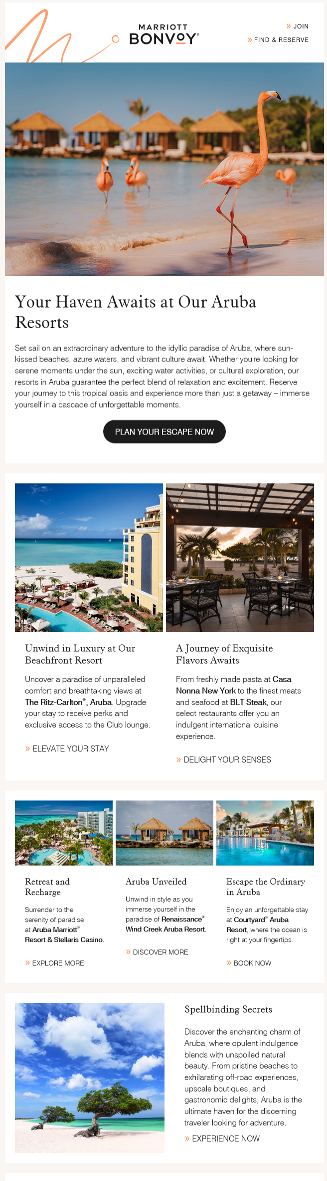
METT: Top Performers
January 2024
Top Revenue Generator
Rev: $1,366
Top Overall Performance
CTR: 1.09%
Rev: $945
CALA_Aruba_5Jan2024-Eng
Subject Line:
‘Bask in Aruba's Tranquil Beauty’
CALA_CarnivalBr_26Jan2024-Por
Subject Line:
‘Mergulhe no Ritmo Vibrante do Carnaval Brasileiro’
‘Immerse yourself in the Vibrant Rhythm of Brazilian Carnival’

Slide 25
Testing & Optimization

Slide 26
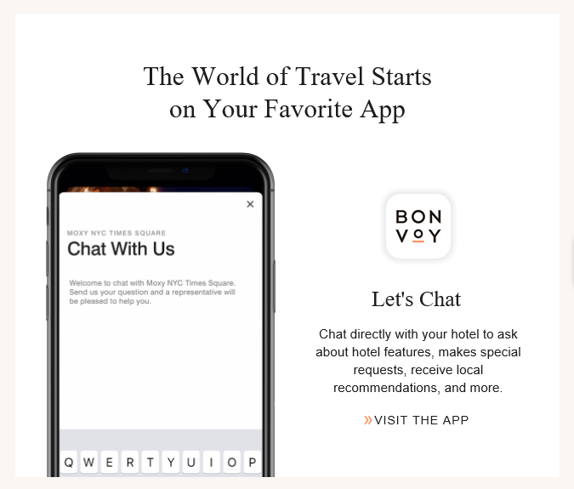
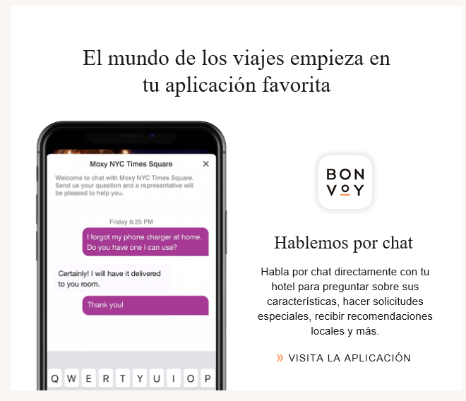
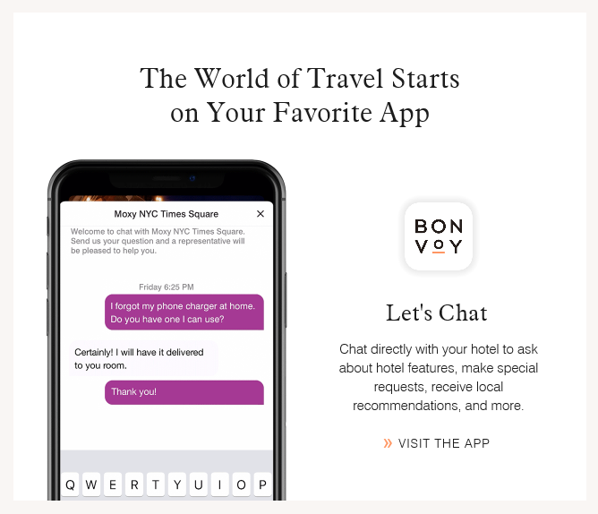
Destinations Solo: Mobile App Creative Testing
Visual refresh every 3-4 months to educate and retain engagement.
Establish a schedule for remainder of year. Click activity and download metrics will help determine which app features to promote.
January 2024
November, Mobile App,
English Version
Module CTR: 1.4%
December, Mobile App,
Spanish Version
Module CTR: 0.7%
January, Mobile App,
English Version
*Jan Mobile App module click data unavailable.
Notes:
there are corporate goals for app download
What are other campaigns doing for mobile app?
May
June
July 1.3% CTR

Slide 27
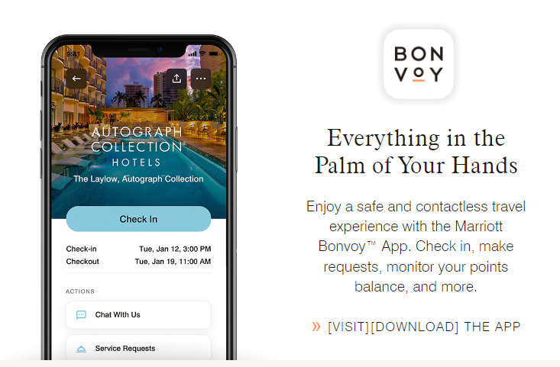

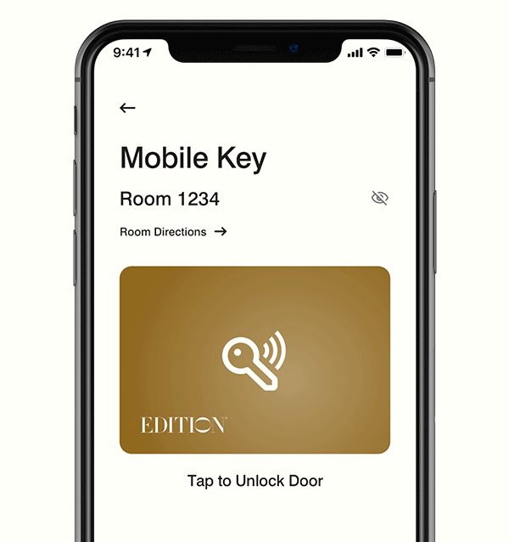
Destinations Solo: Mobile App
2023 Creative Examples
Mobile App,
English Version
May Module CTR: 0.5%
Mobile App,
English Version
Jul Module CTR: 1.3%,
Aug Module CTR: 0.8%
*Jun Mobile App also used ‘Palm of your Hand’ creative and messaging. Module click data currently unavailable.
Notes:
Palm of your hands
Mobile Key ‘go right in’
June
there are corporate goals for app download
What are other campaigns doing for mobile app?
May
June
July 1.3% CTR

Slide 28
Actionable Insights

Slide 29
Actionable Insights
Produce RAPPI content to demonstrate ‘how to’ link accounts and ‘how to’ order and earn to support click engagements. Set soft goal of 5% of unique clicks within RAPPI module.
Jan featured a non-CTA hero within global/local campaigns. In turn, secondary module performance captured above the fold clicks. Obtain first click sooner using CTA within hero. If using an editorial approach in hero and no CTA featured, consider reducing hero’s size to support secondary module’s CTA performance.
Properties like Renaissance Wind Creek Curacao Resort, a Jan top revenue driver among CALA properties, is near a cruise port. Create a link for audiences by including the Cruise With Points module when properties featured near a port.
Select Traveler content that focuses primarily on CALA to support revenue to CALA properties.
Establish strategic refresh of Featured Destinations. Project Silk’s experiences a spike in engagement with newer destinations rotated into Featured Destinations module.
Track mobile app engagement for Destination Solo and Global/Local campaigns to broaden insights on creative treatments and messaging differences. Refresh mobile app download reporting once available.
Monitor percent of non-booking, lower performing METTs to identify potential trends in messaging and or timing.
Continue monitoring unsub rate trends and compare to overall Bonvoy patterns.

Slide 30
Appendix

Slide 31
Destinations Solo: Targeting Definitions

