Slide 1



Max ADR Use Case Planning
Q1 2022

Slide 2

Campaign Strategy Discussion Areas:
Q4 ‘22- Q1 ‘23 Key Initiatives & Next Steps
Measurement & Reporting
Luxury Segment Versioning
Max ADR Attribute ($750+)
With the Core MAU Control group suppression being lifted in September what is the best measurement approach moving forward to assess Lux MAU performance?
Explore various options including initial set of measurement options that were discussed prior to initial campaign launch (Universal, Luxury Campaign Overall Suppression for Lux Segments, Re-instatement of Core MAU Control group) in conjunction with Luxury Segment Level Control Group options
How do we leverage prior learnings to inform new content/offer testing opportunities to drive lift in key engagement and financial metrics?
Develop strategic approach and plan for each segment based on desired goals/objectives associated with each
Build overarching content matrix at each luxury segment level to highlight differences in interest by content and offer type
With the recent availability of the Max ADR ($750+) attribute, what use cases can we put in market for Q1?
Aligned on key areas for use case development on 11/14:
Upsell opportunities for specific types of suites
Leverage known brand stay trends and loyalty behavior to support and inform content opportunities (Target brand loyalist with brand specific content)
Develop use case options for Q1

Slide 3
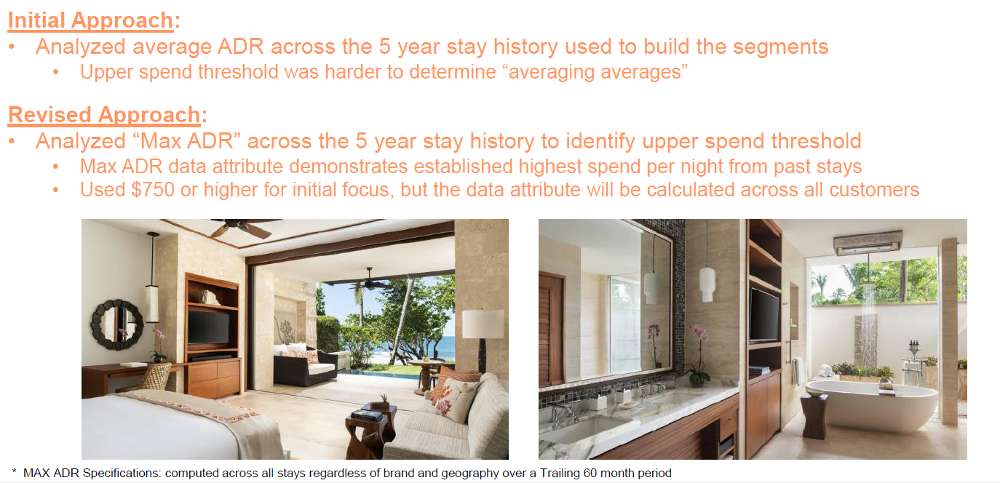
Overview: Max ADR Activation

Slide 4
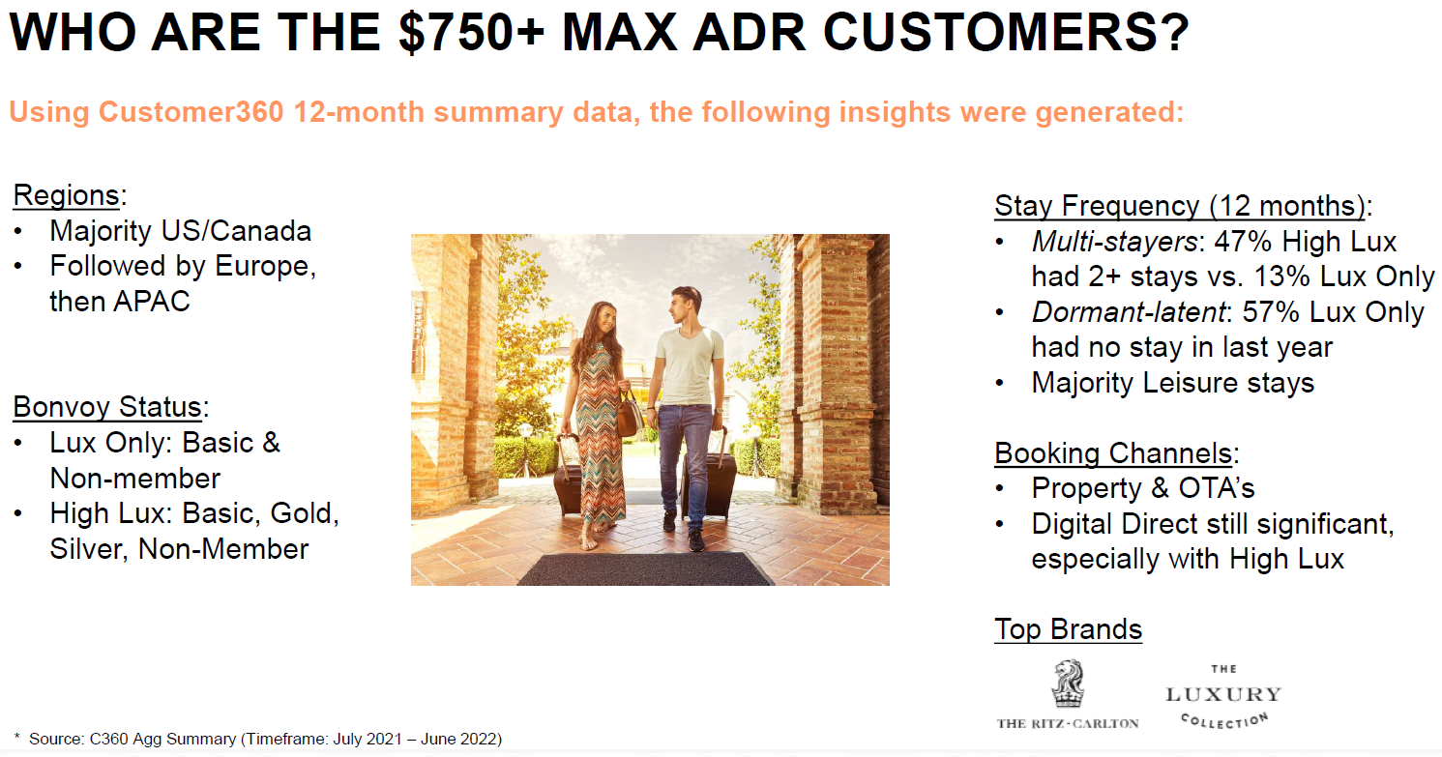
Overview: Max ADR Audience

Slide 5
Max ADR: Data Attributes
Available for all consumers:
Max Average Daily Rate (ADR) Value – maximum ADR over last 5 years
Will focus on target audience with Max ADR of $750-$999 as well as $500-$749 and $1k+
Affiliated Brand - brand that is tied to the Max ADR
Stay Frequency – frequency of stays at the brand level
Affiliated Stay Night Date– recency of stays at the brand level
To identify Brand Loyalists: Further Definition Needed
Associated Brand + Stay Frequency
To identify Dormant audience: Further Definition Needed

Slide 6
5 Use Case Opportunities for Max ADR Audiences
Upsell:
Suite/Club Level Activation – Lux MAU
Luxury Brand Awareness:
Luxury Brands Module- Core MAU
Brand Loyalty:
Brand Loyalist Dedicated Module- Lux MAU for Ritz and The Luxury Collection
Brand Reactivation – Ritz eNews
Brand Reactivation – Lux MAU
Initial Use Cases: Phase I
Further Scoping Needed: Phase II

Slide 7
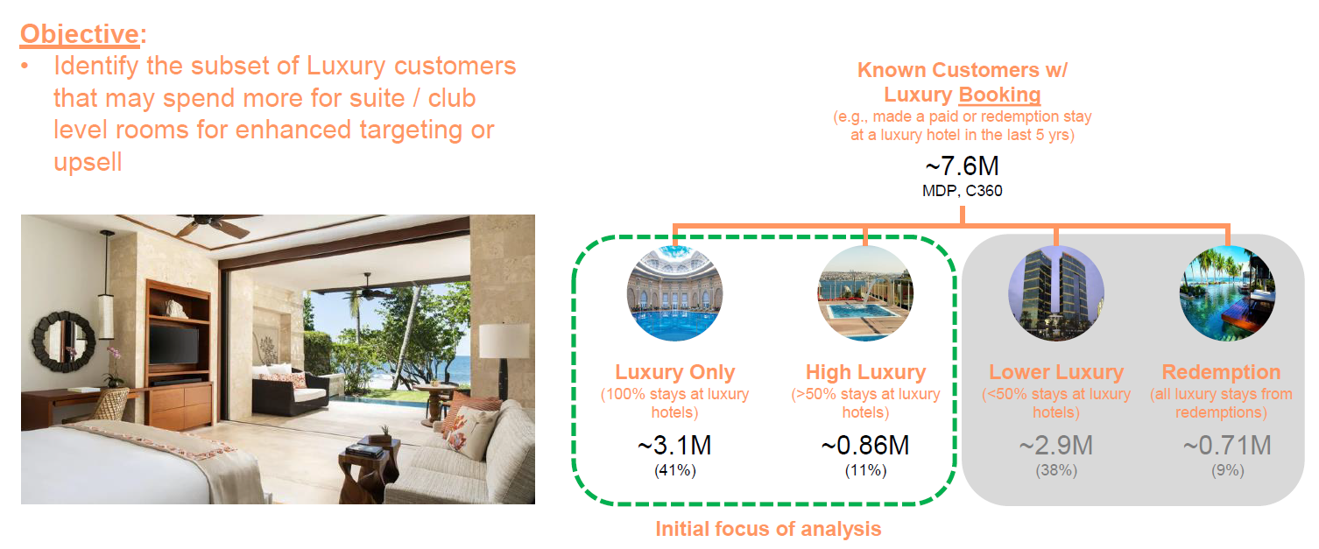
Overview: Lux MAU U.S. Suite/Club Level Module

Slide 8
Test Strategy: Lux MAU U.S. Suite/Club Level Module
Audience: Max ADR Luxury Segments (Members and Non-Members)
Objective: Understand if including a module that showcases Suites/Club level drives interest from our High ADR luxury customers
Hypothesis: Leveraging Lux MAU to drive awareness of Suites/Club Level offering will drive incremental engagement and bookings
Outcome:
Determine if Lux MAU is a viable messaging vehicle to drive incremental Suite/Club level engagement and bookings
Tactic:
A/B split Max ADR audience into: $500-$749 ADR, $750-$999 ADR, $1k+ ADR
Test a Suite/Club Level module to 50% of each ADR bucket on a quarterly cadence for 2023 (June, September, December)
Initial creative treatment will be the same for all cohorts; insights will drive opportunity to test into creative versions
Recommend giving the module secondary hero treatment to ensure test audience is able to engage with module
KPIs:
Primary: Module BPK (Focused on luxury suite or Club Level contribution) and CTR
Secondary: Module & Halo: Bookings, Revenue, CTR, Unsub Rate, BPK, and Conversion Rate
Recommend doing an initial analysis 30 days after June deployment and a full analysis 30 days after December for entire time period
Considerations:
Initial test targeting the Lux MAU U.S. and Canada
If we can gain incrementality then future testing can include in-language versions, messaging strategies and creative treatment

Slide 9
Audience: Lux MAU Suite/Club Level Module
Luxury Members L1/L2A
Approx. 860k
$500 - $749
Max ADR
$750- $1000
Max ADR
$1k +
Everyone Else
TBD
TBD
TBD
TBD
TBD
TBD
TBD
Audience Split 50/50
Lux MAU/Suite or Club Level Module
Lux MAU/
No Suite or Club
Level Module

Slide 10
Suite Upsell: Content Considerations
Can we get a unique URL that points towards the Suite hotel options specific to Luxury Brands:
https://www.marriott.com/offers/suiten-your-stay-in-the-us-and-canada-1355717
Other available content includes:
https://www.ritzcarlton.com/en/services-amenities/suites-villas#
https://www.ritzcarlton.com/en/hotels/china/macau

Slide 11
Test Strategy: Core MAU ENG Luxury Brand Module
Audience: Max ADR Non-Luxury Segments (Members Only)
Objective: Understand if including a module that creates awareness around the luxury brands drives interest from our non-luxury customers that have a High ADR
Hypothesis: Leveraging Core MAU to drive awareness of luxury brands will drive incremental engagement and bookings
Outcome:
Determine if Core MAU is a viable messaging vehicle to drive incremental luxury engagement and bookings
Tactic:
A/B split Max ADR audience into: $500-$749 ADR, $750-$999 ADR, $1k+ ADR
Test a luxury brand awareness module to 50% of each ADR bucket on a quarterly cadence for 2023 (June, September, December)
Initial creative treatment will be the same for all cohorts as Offer 1; insights will drive opportunity to test into creative versions
KPIs:
Primary: Module BPK (Focused on luxury contribution) and CTR
Secondary: Module & Halo: Bookings, Revenue, CTR, Unsub Rate, BPK, and Conversion Rate
Recommend doing an initial analysis 30 days after June deployment and a full analysis 30 days after December for entire time period
Considerations:
Initial test targeting the Core MAU English version targeted to U.S. and Canada
If we can gain incrementality then future testing can include in-language versions, messaging strategies and creative treatment

Slide 12
Audience: Core MAU ENG Luxury Brand Module
Non- Luxury Members
20.8 M
$500 - $749
Max ADR
$750- $1000
Max ADR
$1k +
Everyone Else
TBD
TBD
TBD
TBD
TBD
TBD
TBD
Audience Split 50/50
Core MAU/Lux Brand Module
Core MAU/
No Lux Brand Module

Slide 13
Luxury Brand Awareness: Content Considerations
Have cohesive brand led portion of creative that features luxury brands
In conjunction, consider rotating themes for each quarter to refresh content including featuring education focused content, offer content, etc.

Slide 14
2023 Roadmap | Max ADR Use Cases
Phase I Use cases will be focused on Upsell and Luxury Brand Awareness
Further scoping needed around dormant/brand loyalist definition to finalize which brands and campaigns will be quantifiable enough to support a test in which the results will be statistically significant
Indicates test in market
Max ADR Primary Objective | Q1 | Q2 | Q3 | Q4*
Upsell
Luxury Brand Awareness
Brand Loyalty
Initial Creative Asset Development
Initial test analysis
Use Case Planning
Jun LMAU
Sep LMAU
Dec LMAU
Suite/Club Level Upsell Testing and Analysis
Initial Creative Asset Development
Initial test analysis
Use Case Planning
Jun Core MAU
Sep Core MAU
Dec Core MAU
Luxury Brand Education & Content
Brand Loyalty Scoping and Sizing
Sep-Oct
Brand/Campaign TBD
Brand Reactivation
Scoping and Sizing
*Final test assessment will occur within 30 days of December tests
Notes:
Erica
Develop a quarterly campaign roadmap that allows us to track when key initiatives will be supported, other program activities/announcements, as well as ongoing test opps
Consider using Workfront to manage
Update quarterly
We’re basically tracking those things that will influence campaign development and performance each month

Slide 15
Next Steps for Phase II Use Cases
Audience Definition
Confirm the definition of the dormant Max ADR audience
Confirm the definition of a brand loyalist as it relates to the Max ADR audience
Brand Sizing
After audiences are further defined and agreed upon determine available audiences at the brand level to identify which campaigns and brands to begin with for use cases in Phase II

